Slide 1
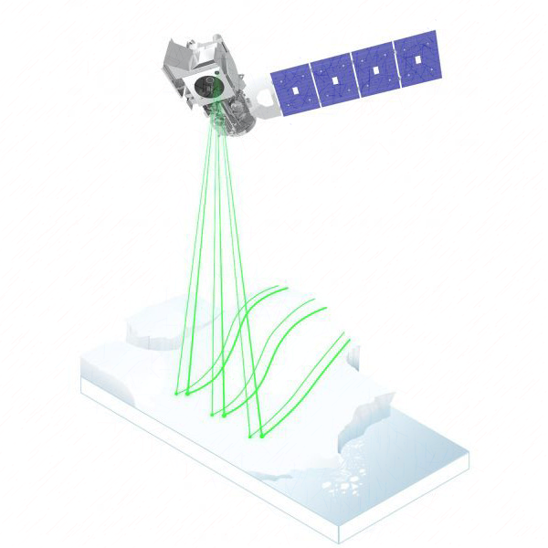

Snow depth retrieval and downscaling using
satellite laser altimetry, machine learning and climate reanalysis
Snow depth retrieval and downscaling using
satellite laser altimetry, machine learning and climate reanalysis
A case study in mainland Norway
Zhihao LIU
2023-06
Supervisor | Andreas Max Kääb, Désirée Treichler
Projects | SNOWDEPTH: Global snow depths from space-borne remote sensing for permafrost, high-elevation precipitation, and climate reanalyzes
Notes:
This title has so many keywords(click). I but the main idea is to (1) get snow depth from satellite laser altimetry, and (2) use it in downscaling of climate reanalysis. The machine learning is used to help in both steps.

Slide 2


Downscaling and subgrid variability
+ details by AI
150 × 211
Original
3000 × 4220
AI Generated
The distribution patterns of snow repeat year after year (Sturm &Wagner, 2010; Trujillo et al., 2007).
Face pattern and snow patterns are both predictable
Bernd’s profile https://www.mn.uio.no/geo/english/people/aca/geohyd/bernde/
Photo up-sampling tool: https://huggingface.co/spaces/Xintao/GFPGAN
Sturm, M., & Wagner, A. M. (2010). Using repeated patterns in snow distribution modeling: An Arctic example. Water Resources Research, 46(12)
Notes:
Image super respolution. What does it means for snow depth? (click)
Varies literature pointed the distribution patterns of snow repeat year after year due to their dependence on topography, vegetation, and weather patterns. Which means it is predictable, like a face. But how to do that, I today I will share the ideas from my thesis.

Slide 3
Downscaling and subgrid variability
Image | Snow depth
Low-res image
ERA5 Land
The objectives:
Derive high-res snow depth from ICESat-2 using elevation differencing workflow:
Co-registration
Bias correction on DEM
Validation
Develop a statistical downscaling model
+ details
+ subgrid variability
Predictor
Predictor
High-res samples
High-res observations
High-res image
Snow depth product
at hillslope scale
Bernd’s profile https://www.mn.uio.no/geo/english/people/aca/geohyd/bernde/
Photo up-sampling tool: https://huggingface.co/spaces/Xintao/GFPGAN
Sturm, M., & Wagner, A. M. (2010). Using repeated patterns in snow distribution modeling: An Arctic example. Water Resources Research, 46(12)
Notes:
For a low-resolution image, it can be interpolated to high-res image easily, which is meaningless. The key is to add the details.
For snow depth downscaling, the key is to have a predictor (click) to estimate subgrid variability. The predictor should be properly trained by high resolution snow depth observations (click). And this is the most of challenge, but also excited part of this study
Following by this idea (click), the objectives of my study is to derive the snow depth from ICESat-2. And use it in statistical downscaling.

Slide 4
Snow depth retrieval and downscaling using
satellite laser altimetry, machine learning and climate reanalysis
Part 1: Background
Snow is important
Snow depth is a big-unknown
Snow depth observation is challenging
Study area & Data setting
Part 2: Method
Co-registration
Bias correction
Downscaling
Part 3: Results and Discussion
Part 4: Conclusion and Outlooks
‘three things about snow’
‘CBD’ workflow
Outline
Notes:
Before I elaborate on the technical details, I will share three things about snow to explain my motivations.
After this technical thing, I call it ‘CBD workflow’ (click). I will present the results for each step, from very boring co-registration and bias correction to excited downscaling.
In the end, I will share ideas how to further refine my results and why my results is useful for other studies.

Slide 5
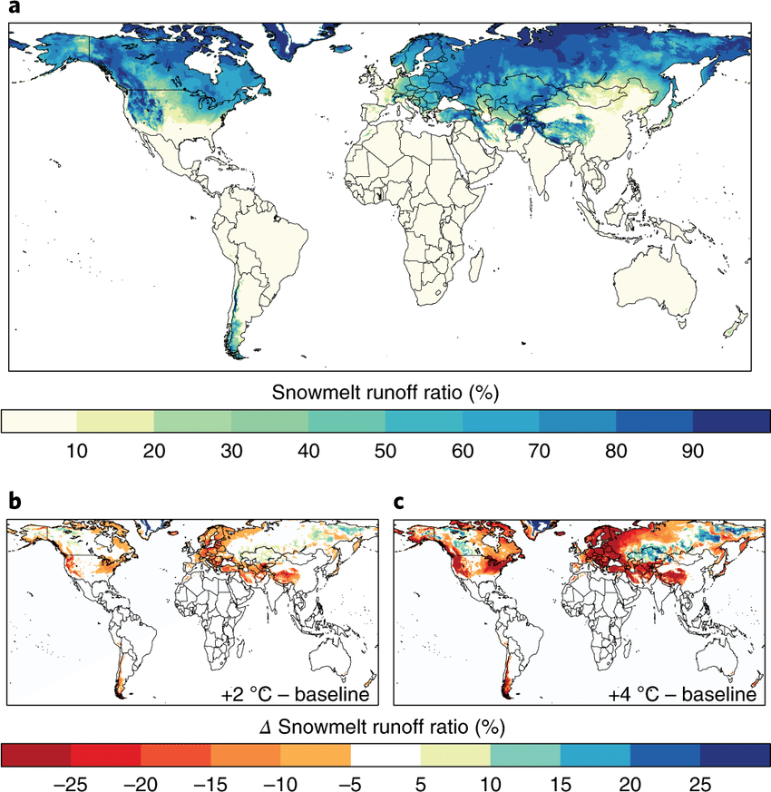
1/3 Snow is important
Seasonal snow serves as an essential water reservoir, especially in mountainous regions.
Nevertheless, precisely ascertaining the snow depth remains a challenge, especially in mountainous regions.
Bormann, K. J., Brown, R. D., Derksen, C., & Painter, T. H. (2018). Estimating snow-cover trends from space. Nature Climate Change, 8(11), 924–928.
Mudryk, L. R., Derksen, C., Kushner, P. J., & Brown, R. (2015). Characterization of Northern Hemisphere Snow Water Equivalent Datasets, 1981–2010. Journal of Climate, 28(20), 8037–8051.
Notes:
In Norway, on average, approximately 50% of runoff is from snowmelt, and 90% electricity is from hydropower. Snow is very important season water reservoirs. Not just for Norway, the graph here shows how much run-off comes from snow melting over the world. This area in blue is called snow-melt catchment. The alterations of snowpacks can significantly impact water availability not just in this area but also the down-stream, over billion population rely on melting water.
However, estimating snow depth in such environment remains a challenge.

Slide 6
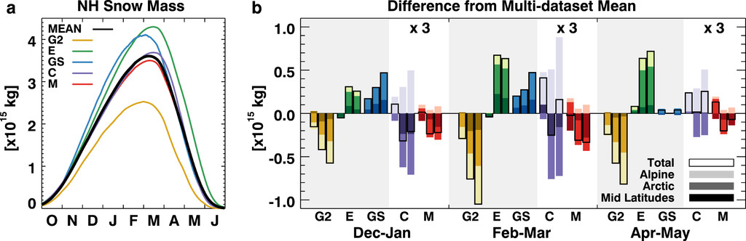
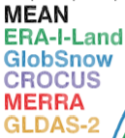

2/3 Snow depth is the big unknown
(1) Global snow mass products vary as much as 50% (Mudryk et al., 2015). Mountainous areas are masked out (Bormann et al., 2018).
1200 Gt
1981-2010 period
Bormann, K. J., Brown, R. D., Derksen, C., & Painter, T. H. (2018). Estimating snow-cover trends from space. Nature Climate Change, 8(11), 924–928.
Mudryk, L. R., Derksen, C., Kushner, P. J., & Brown, R. (2015). Characterization of Northern Hemisphere Snow Water Equivalent Datasets, 1981–2010. Journal of Climate, 28(20), 8037–8051.
Notes:
The different global snow mass products presented huge differences. For example, here, the average snow mass from 1981 to 2010, has a difference ranging up to 50% to each other in February.
Among of these products, the mountain area are more problematic. It is often mask-out. because (1) there are few weather stations in such remote areas. (2) and the most common remote sensing techniques are also struggling with resolution, complex terrain.

Slide 7
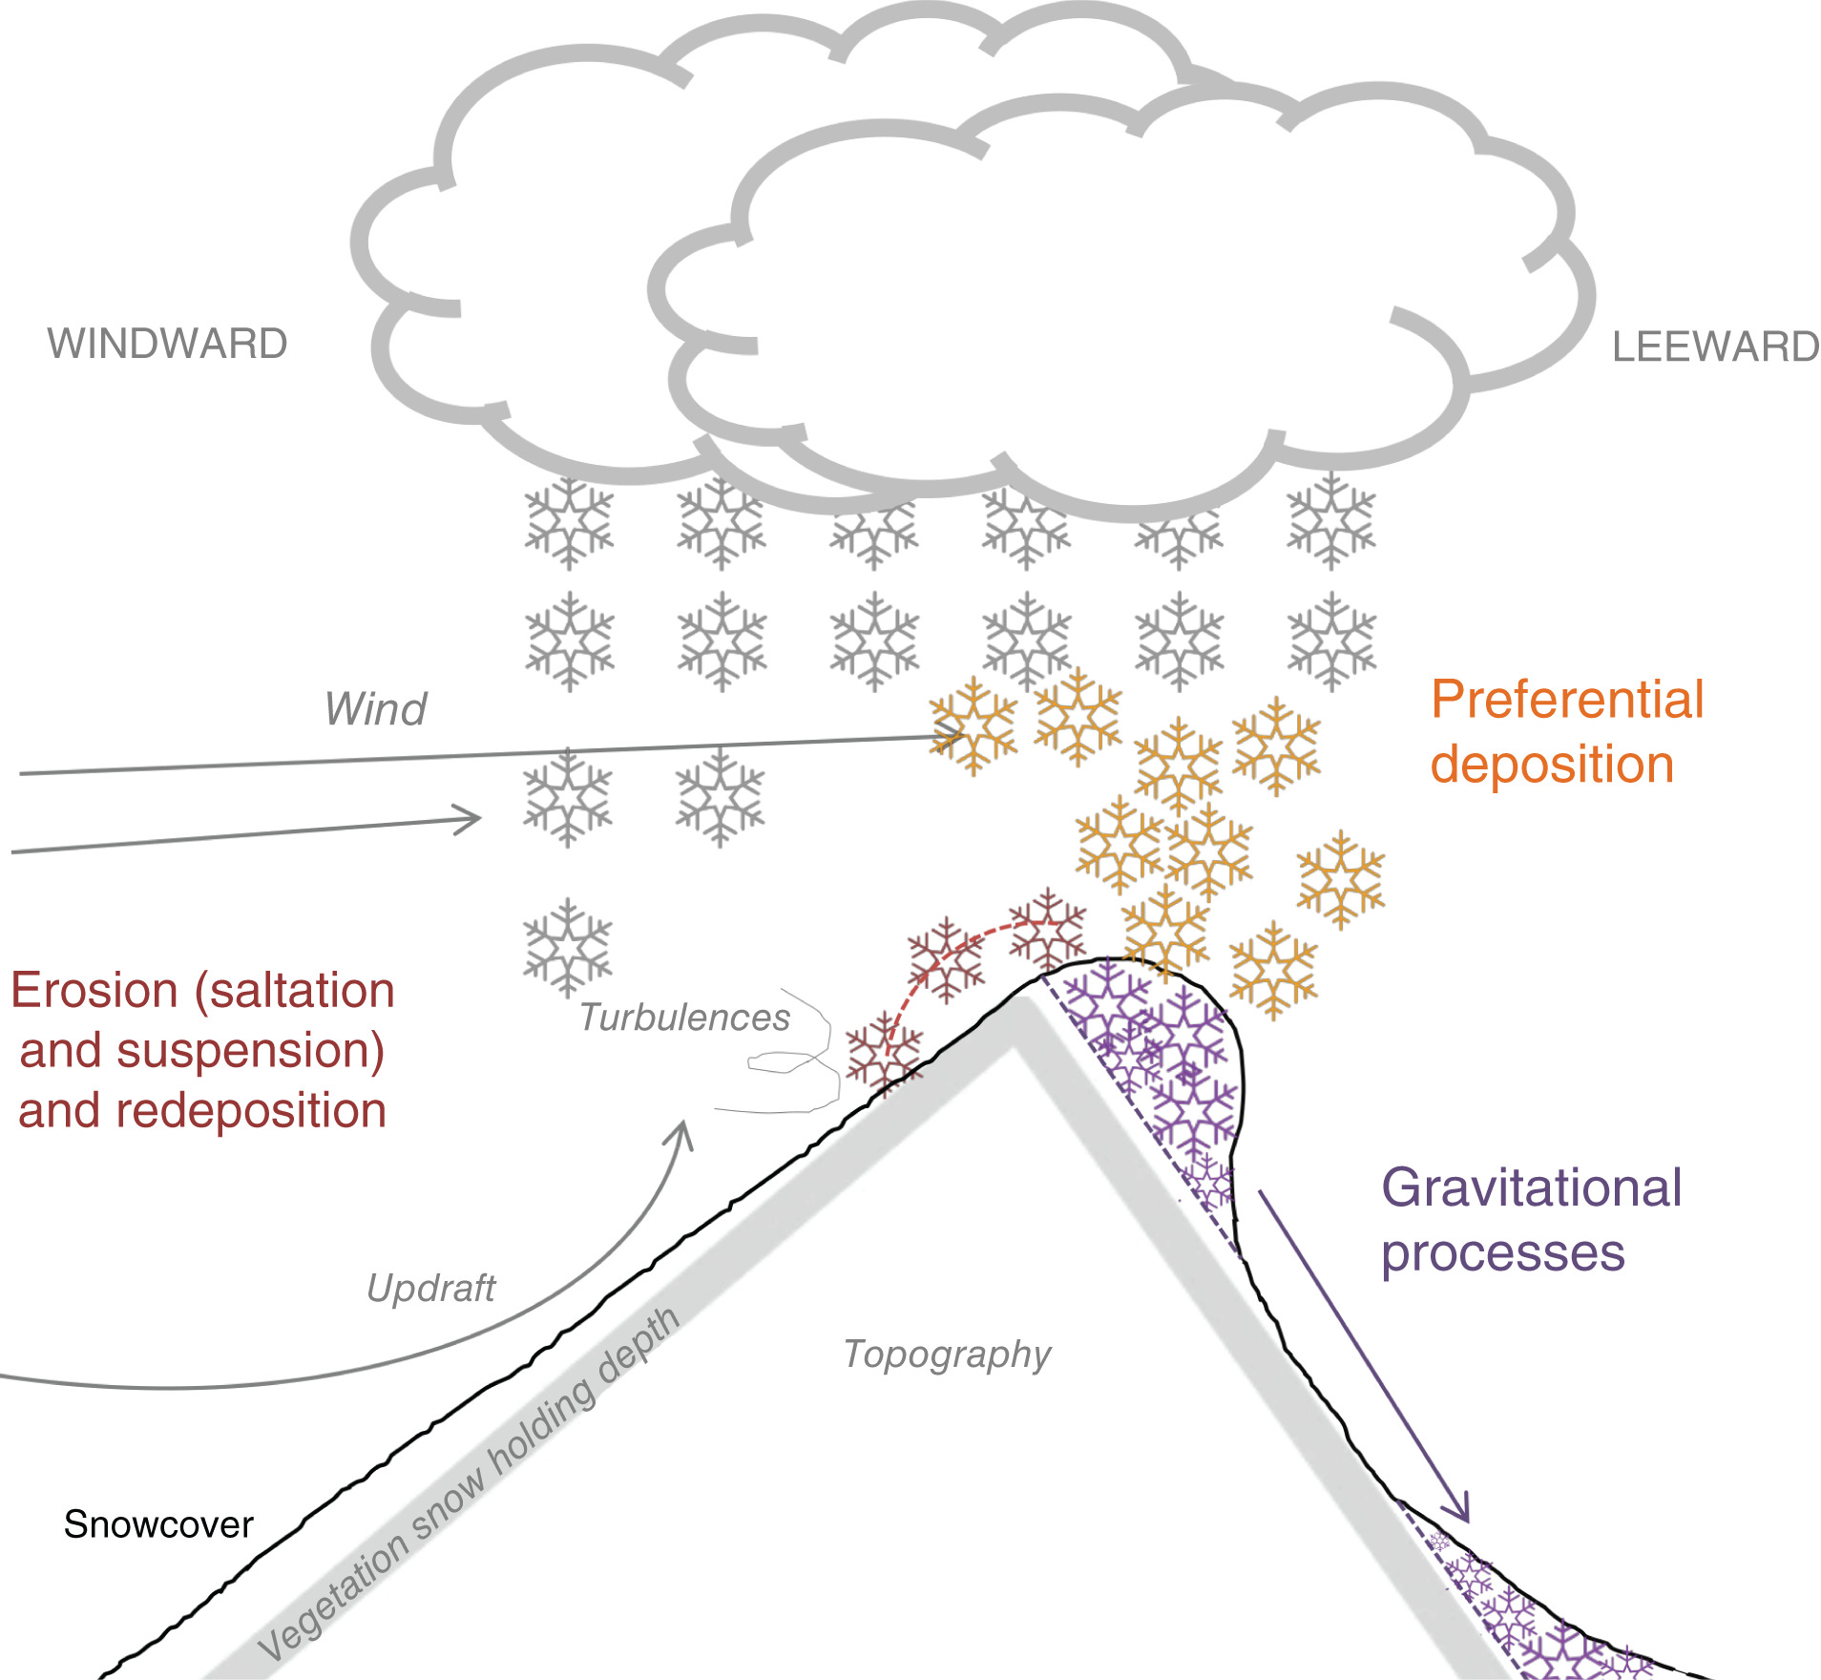
2/3 Snow depth is the big unknown
(1) Global snow mass products vary as much as 50% (Mudryk et al., 2015). Mountainous areas are masked out (Bormann et al., 2018).
(2) In mountain environment, snow has a complex spatial variability due to wind redistribution, vegetation…Sub-grid distribution problem (Freudiger et al., 2017)
1200 Gt
1981-2010 period
Bormann, K. J., Brown, R. D., Derksen, C., & Painter, T. H. (2018). Estimating snow-cover trends from space. Nature Climate Change, 8(11), 924–928.
Mudryk, L. R., Derksen, C., Kushner, P. J., & Brown, R. (2015). Characterization of Northern Hemisphere Snow Water Equivalent Datasets, 1981–2010. Journal of Climate, 28(20), 8037–8051.
Freudiger, D., Kohn, I., Seibert, J., Stahl, K., & Weiler, M. (2017). Snow redistribution for the hydrological modeling of alpine catchments. Wiley Interdisciplinary Reviews: Water, 4(5), e1232.
Notes:
At the local scale, snow has a complex spatial variability because complicated physical process, wind-redistribution. For example, the upward wind will erode, and redistribute the snow from this side to lee-side.
Most of the observations, for example, the snow depth from weather cannot describe the subgrid distribution of snow depth.

Slide 8
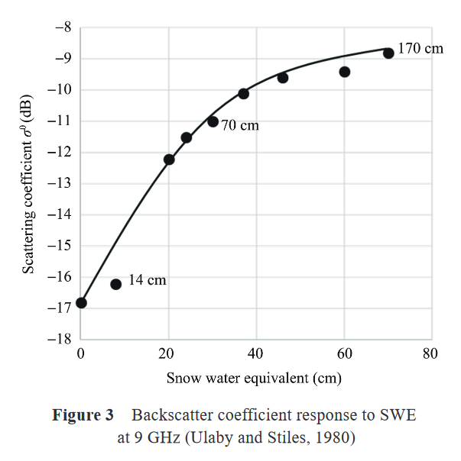
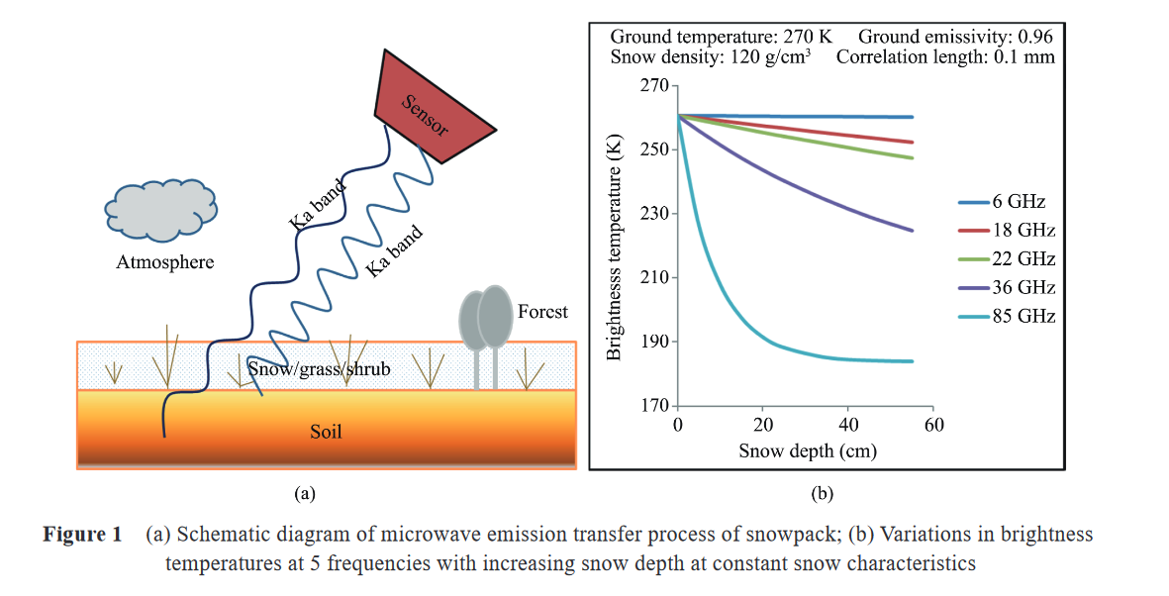



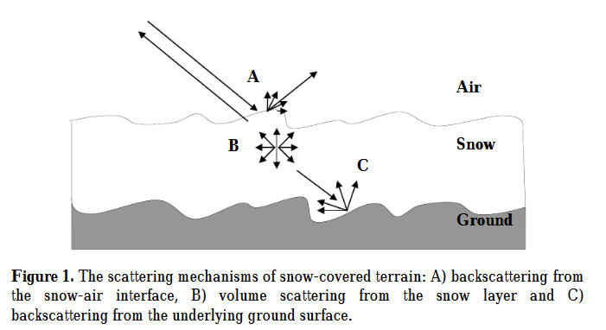
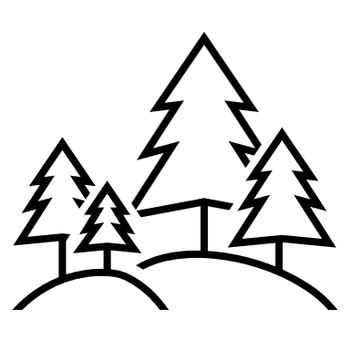

3/3 Snow observation is challenging
(a)
Passive radiometer
(b)
Radar scartering
(c)
Elevation differencing
19 GHz
37 GHz
Vegetation Interference
Liquid water
interference
Resolution
Where is energy from
Notes:
These are several different remote sensing techniques for snow depth today.
Passive microwave radiometers have been used since 1978. The sensor got the signal strength called brightness temperature. The differences between 19 and 37 channels can be used to calculate the snow depth. The typical resolution is 25km, so this method does not work over complex terrain, and doesnt work in vegetated area because of interference. Moreover, the presence of moisture also significantly absorbs microwave.
The active radar scattering singles can also be used. This method has been optimized to estimate dry snow depth at 500 m to 1 km of resolution. The main problem here is we don’t really know where the energy is coming from, it could be from air-snow interface, within snowpack, and snow-ground interface. If there is an ice layer, or ice lens, or moisture, this does not work.
The last commonly used solution is elevation differencing. Surveying the surface twice and calculate the difference, that is the snow depth. This method provides high resolution snow depth. But is local interest, time consuming and expensive. So, it is good for validation.
If this is not drone but the laser altimetry (click) It is going to be cheaper, easier, and everywhere. However, it doesn’t mean it is an easy task.

Slide 9
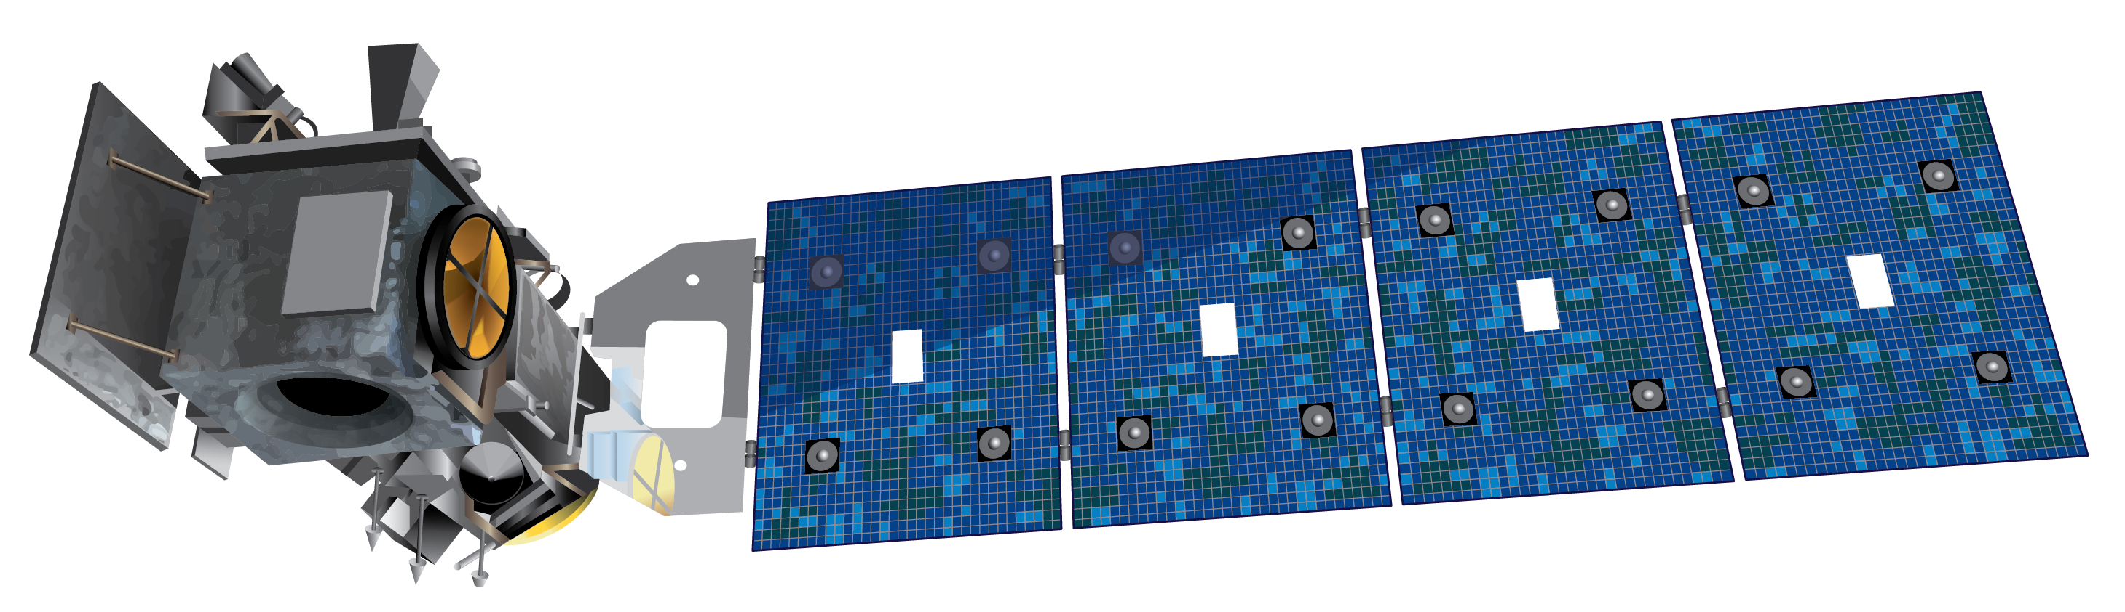
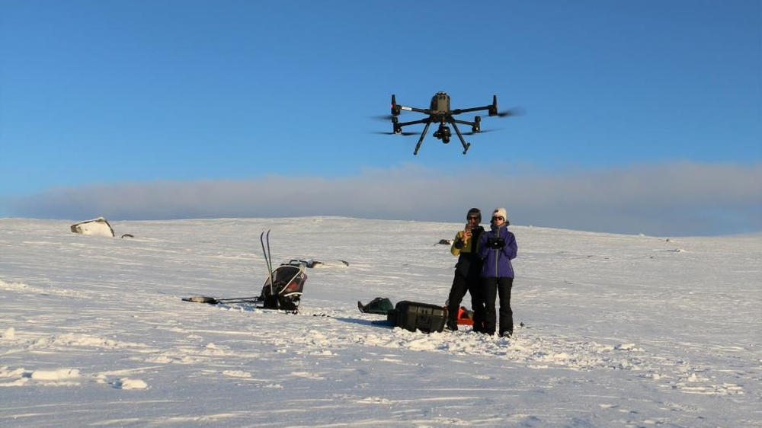
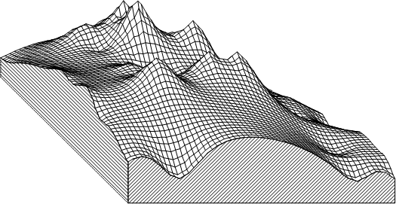
3/3 Snow observation is challenging
(1) ICESat-2 – Snow-on measurements
Challenges of elevation differencing:
DEM’s uncertainties
Co-registration
Bias correction
Validation
(2) Field trip - validation
Hardangervidda, Southern Norway Photo: Eivind Torgersen
(3) Snow-free DEM
Notes:
This is the ICESat-2 satellite, it emits green laser to surface ground, and get the elevation profile.
What kind of challenges are expected to get snow depth?
First, this method requires snow-free DEMs. And the magnitude of snow depth is relatively small, compared to the error associated with DEMs.
Hence, we need to carefully co-registration two datasets.
Moreover, biases are widely present in DEMs. It calls the need for strict quality control and bias correction. Otherwise, we only get noise instead of snow depth.
The results need to be validated, so I joined the field trip and I also get snow depth from NVE.

Slide 10
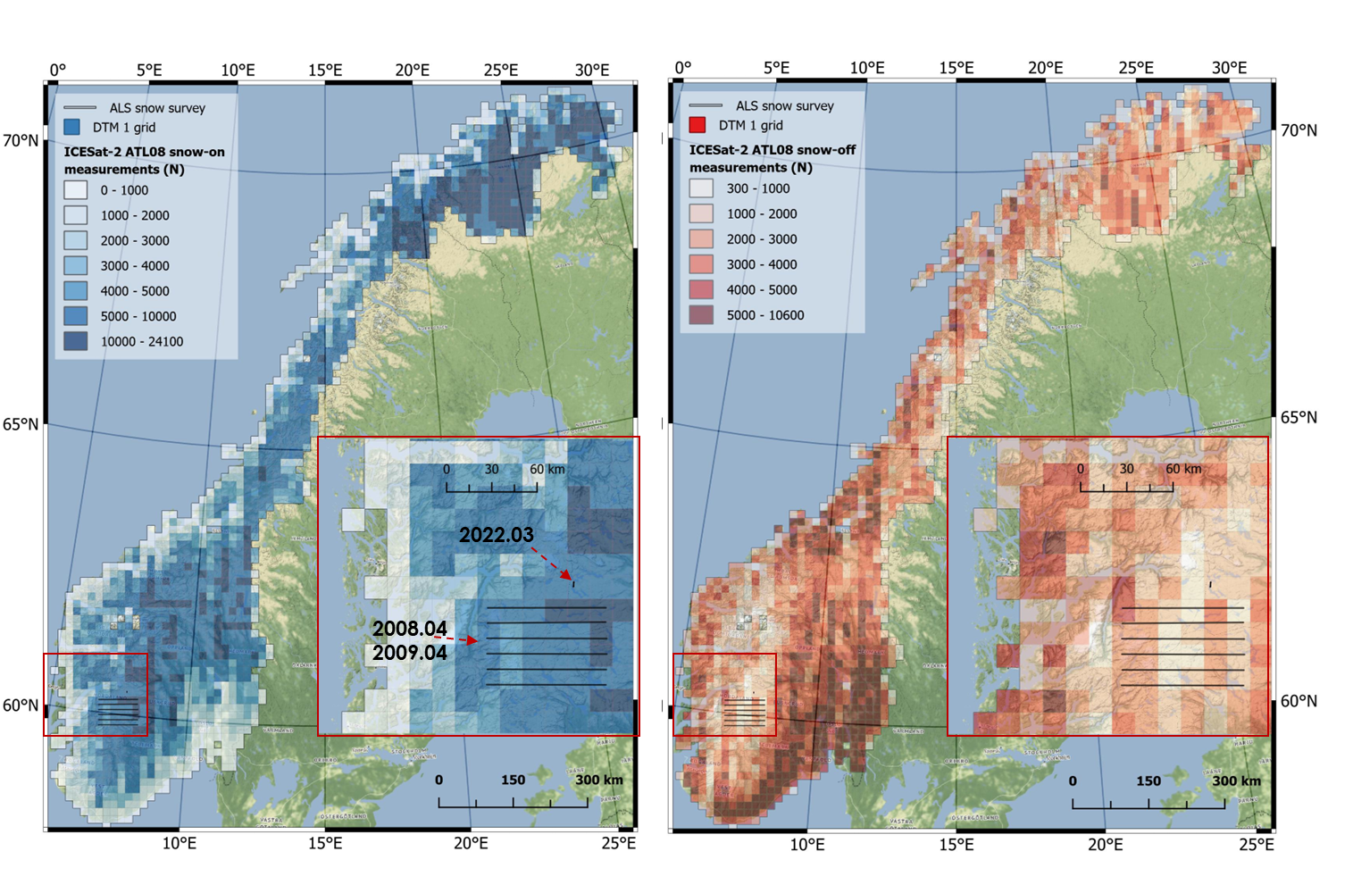
Background | Method ‘CBD’ | Results and Discussion | Conclusion and Outlooks
Study area & Data setting
ICESat-2 ATL08 from 2018.10 to 2022.10.
5,443,945 snow-free segments, excluding moving terrain (permanent ice and inland water)
9,213,030 snow-on segments.
(2) Four DEMs were used as reference grounds for the entire mainland of Norway:
DTM1(1 m)
DTM10 (10 m)
Copernicus GLO-30 (30 m)
FABDEM (Forest And Buildings removed GLO-30, FAB)
(3) ERA5 Land daily snow depth and monthly dataset
(4) Two validation datasets
Snow-on segments
N = 9.2 million
Snow-off segments
N = 5.4 million
Notes:
In this work, I collected ATL8 product from 2018 to 2022, with over 5 million snow-free segments and 9 million snow on segments.
And Four DEM are used as reference grounds to cover the mainland Norway. DTM1 and DTM10 corresponding to resolution 1 m and 10 m. The Copernicus GLO30 is 30 meters digital surface model, and FABDEM is forest and building removed GLO30. By comparing these DEMs, we can explore why the resolution is important and how the vegetation inter-fere the DEM accuracy.
In downscaling workflow, the ERA5 Land products are used, And two validation datasets in Hardangervidda are used.

Slide 11
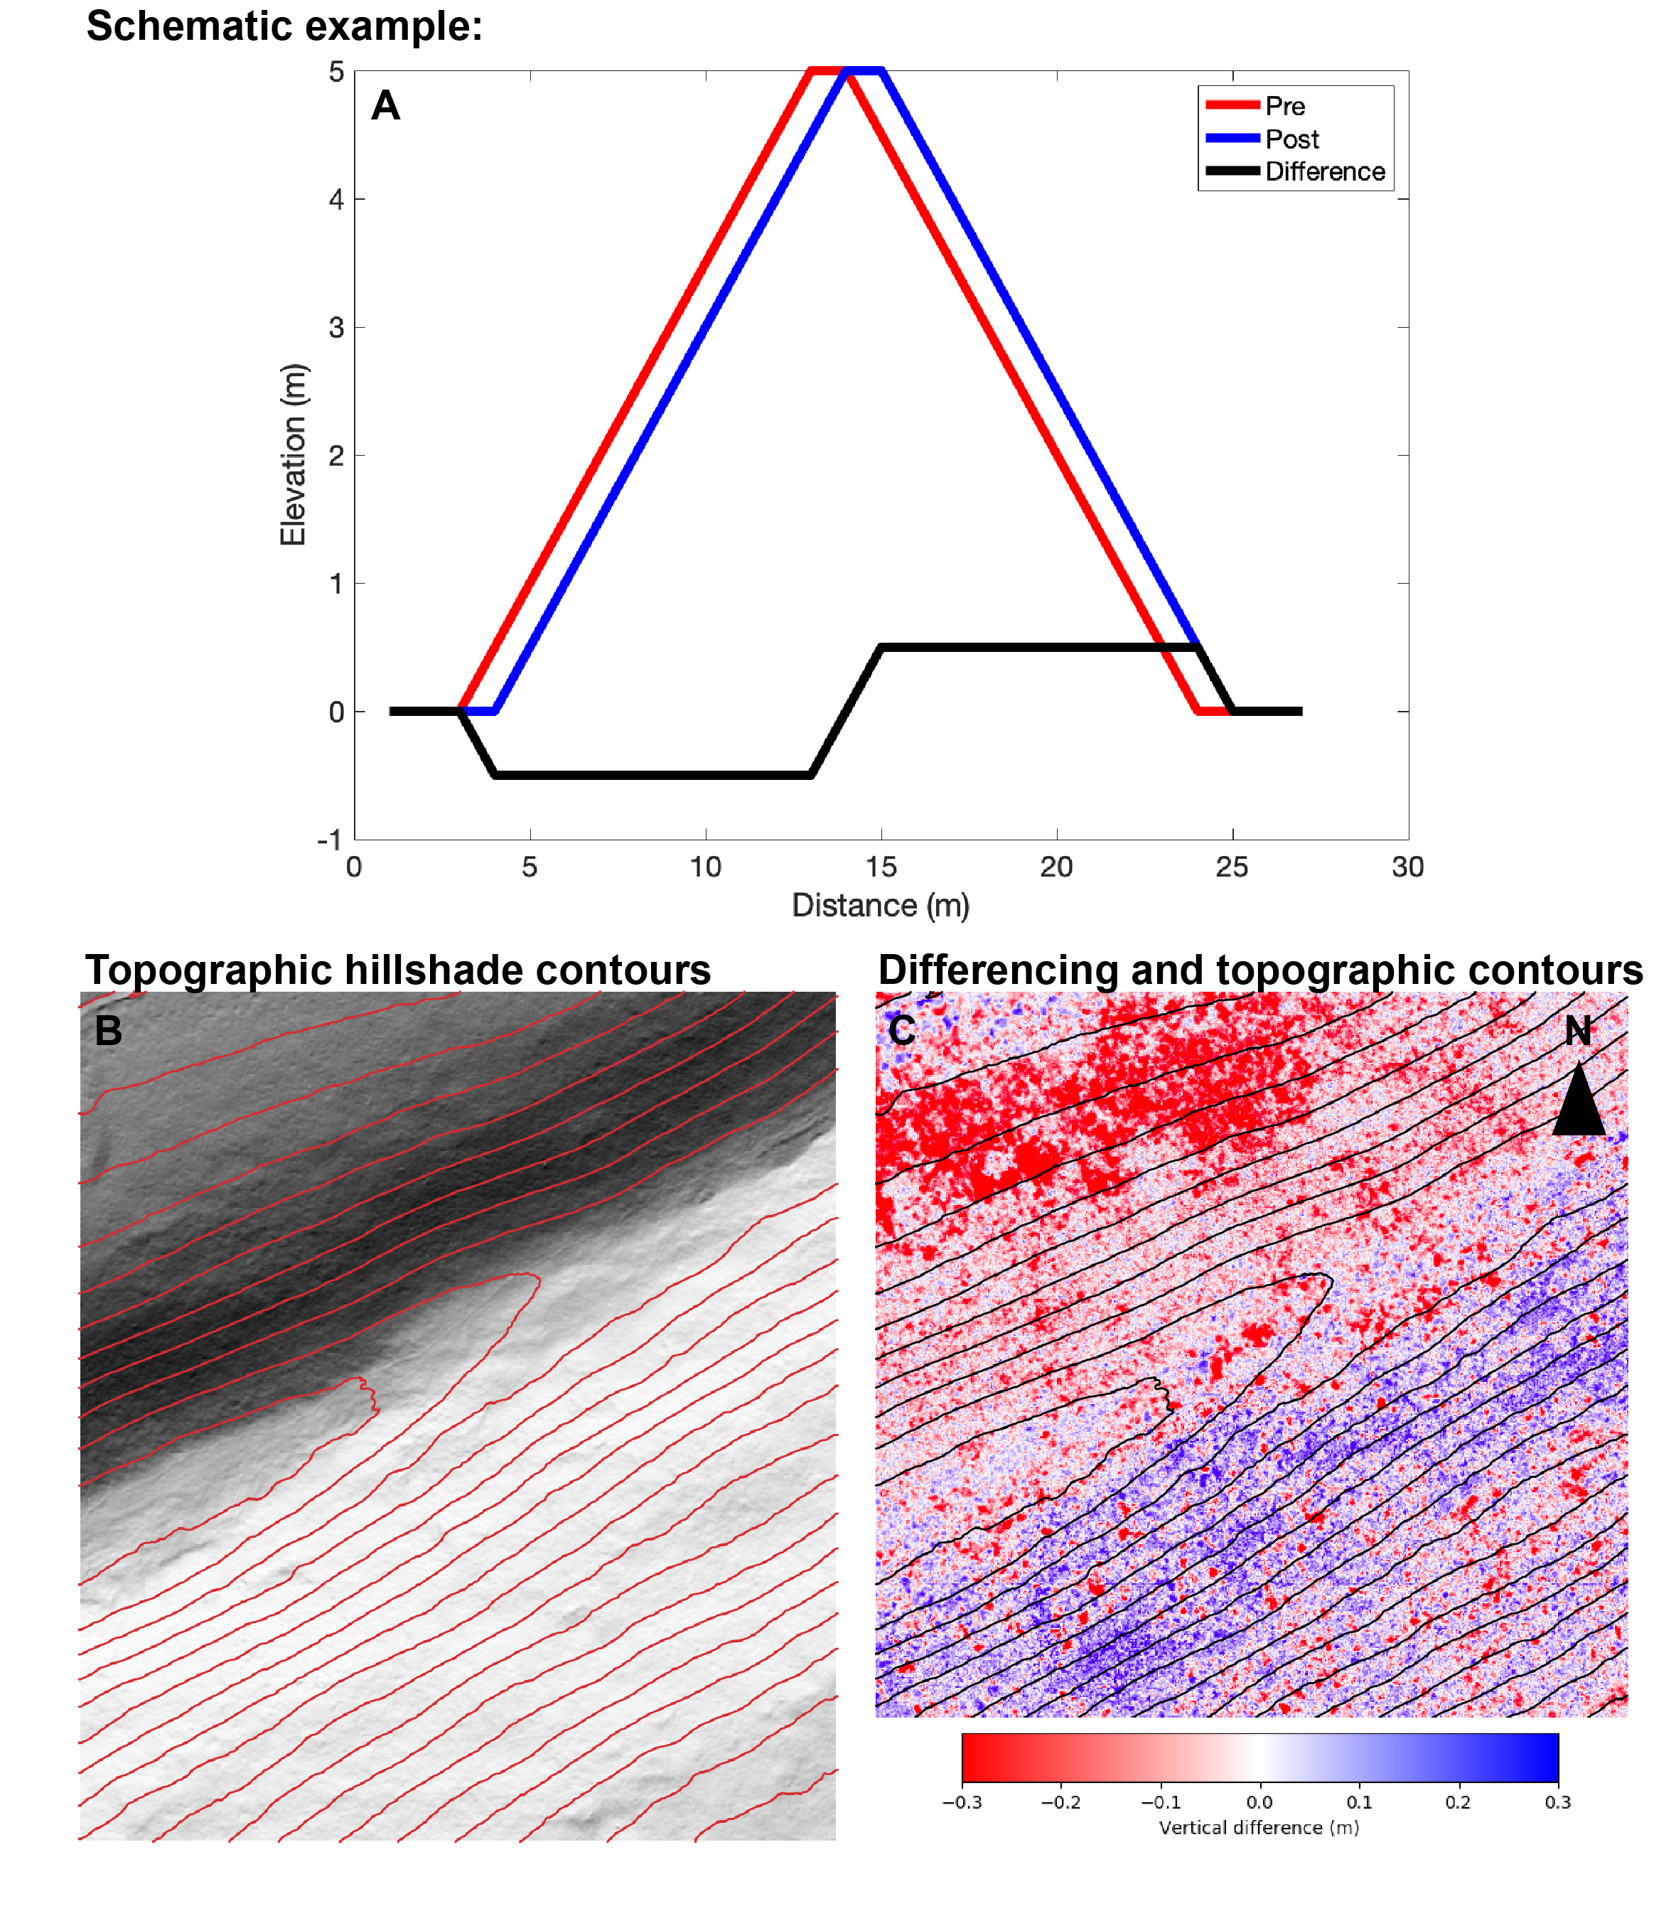
Method ‘CBD’| Results and Discussion | Conclusion and Outlooks
Co-registration: To produce the real differences
In elevation differencing workflow, co-registration of DEM and snow-free segments from ICESat-2 is the first and critical step.
Image from https://opentopography.org/blog/interpreting-errors-topographic-differencing-results
Nuth, C., & Kääb, A. (2011). Co-registration and bias corrections of satellite elevation data sets for quantifying glacier thickness change. The Cryosphere, 5(1), 271–290. https://doi.org/10.5194/tc-5-271-2011
Notes:
Let’s start with our CBD workflow. The co-registration is the first and critical step for elevation differencing.
When a DEM is not in perfect geo-referencing, for example, here, the DEM should be in blue, but in red. The misalignment is going to make an elevation difference that has a relationship correlated to aspect, slope.

Slide 12
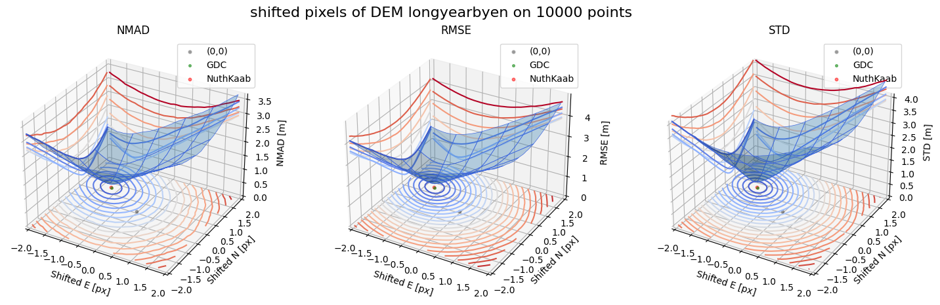
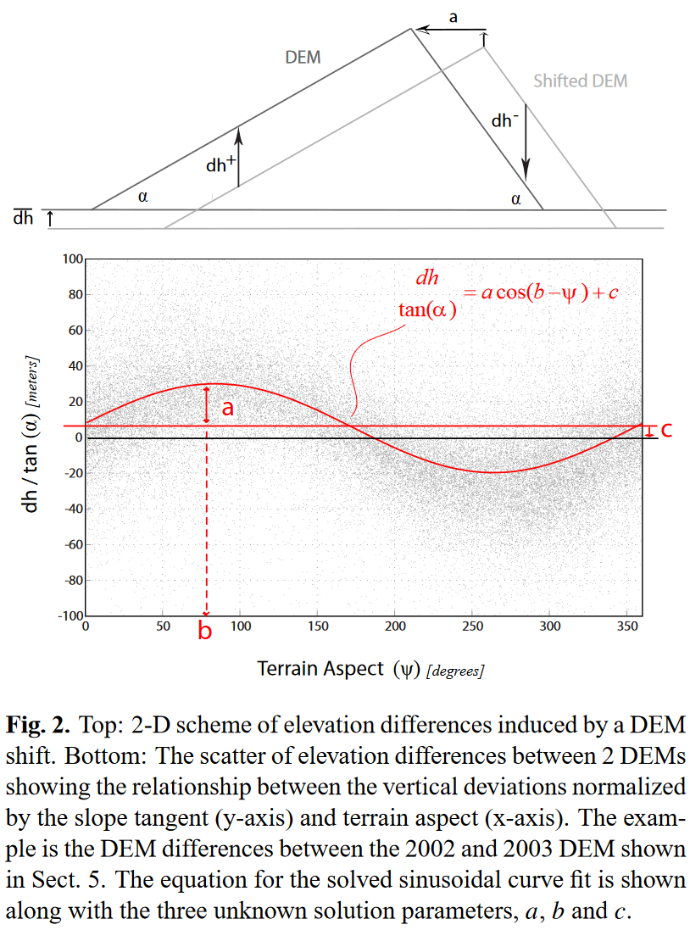
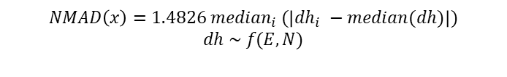
Method ‘CBD’| Results and Discussion | Conclusion and Outlooks
Co-registration: To produce the real differences
(a) NuthKaab Co-registration (2011)
(b) Gradient Descent Co-registration
$$NMAD\left(x\right)=1.4826 {median}_{i} (\left|{dh}_{i} −median(dh)\right|)$$
$$dh \sim f(E, N)$$
Image from https://opentopography.org/blog/interpreting-errors-topographic-differencing-results
Nuth, C., & Kääb, A. (2011). Co-registration and bias corrections of satellite elevation data sets for quantifying glacier thickness change. The Cryosphere, 5(1), 271–290. https://doi.org/10.5194/tc-5-271-2011
Notes:
In NuthKaab co-registration. The relationship has been described by this 2-dimensional curve line, with this equation. The DEM is correctly shifted back, when the curve is a straight line by solving this equation. But this solution requires calculated the slope and aspect, if the research area is entire Norway, and if the DEM is in 1 m of resolution. The workload is going to be crazy.
So, this study created a new algorithm (click), called Gradient Descent Co-registration. It describes the elevation difference in a 3-dimensional curved surface; when the geo-referencing error presents, the NMAD is high, and this algorithm aims to find the shift matrix, resulting in the minimal of NMAD.
Here the NMAD is a statistical metrics, can be regarded as the robust version of root-mean-square error.

Slide 13
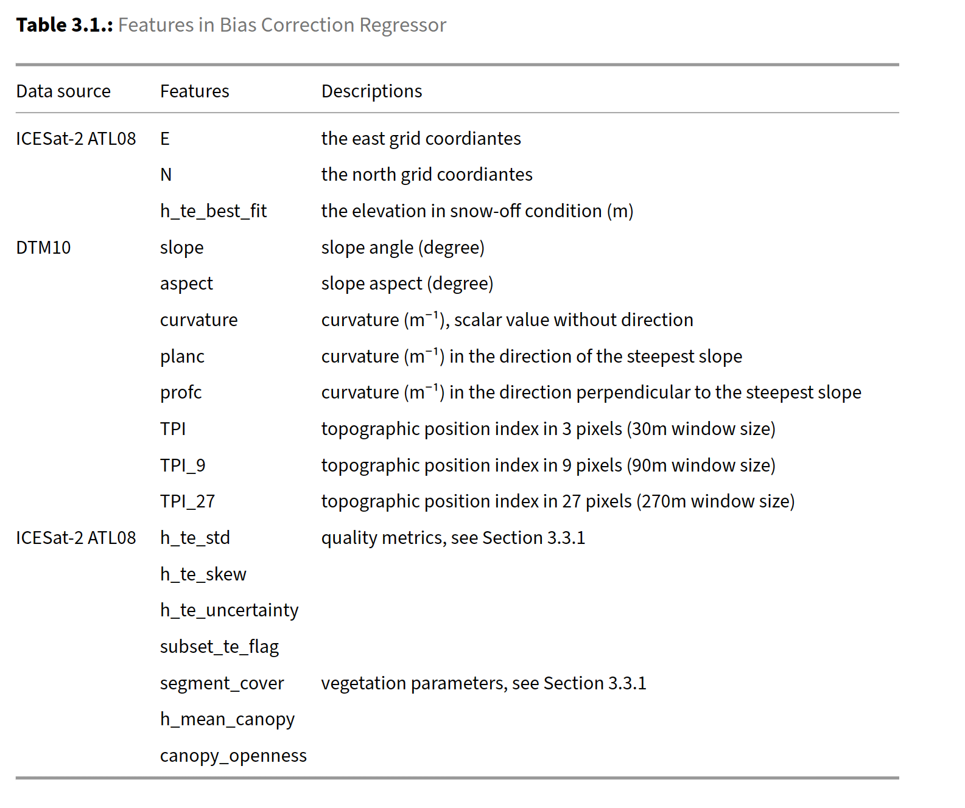
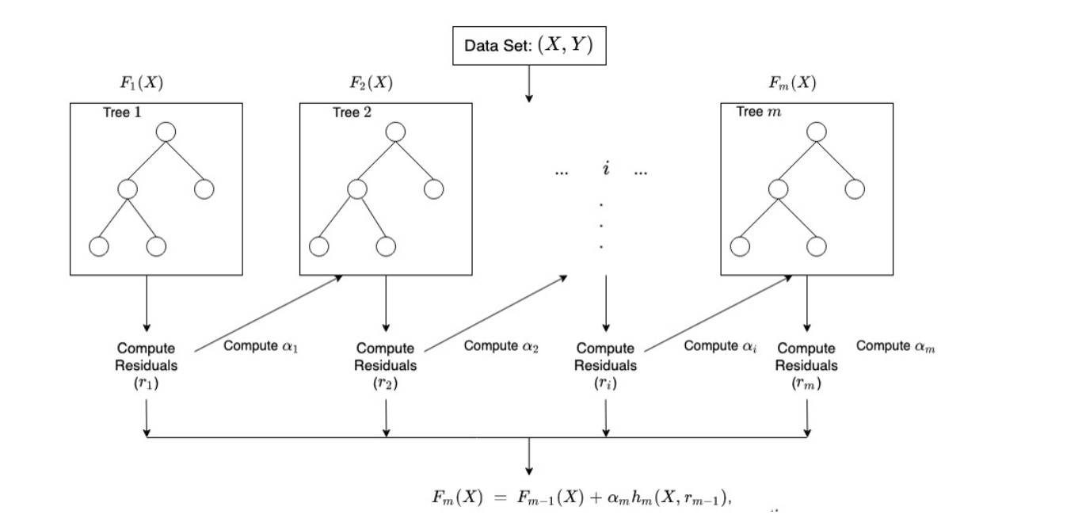
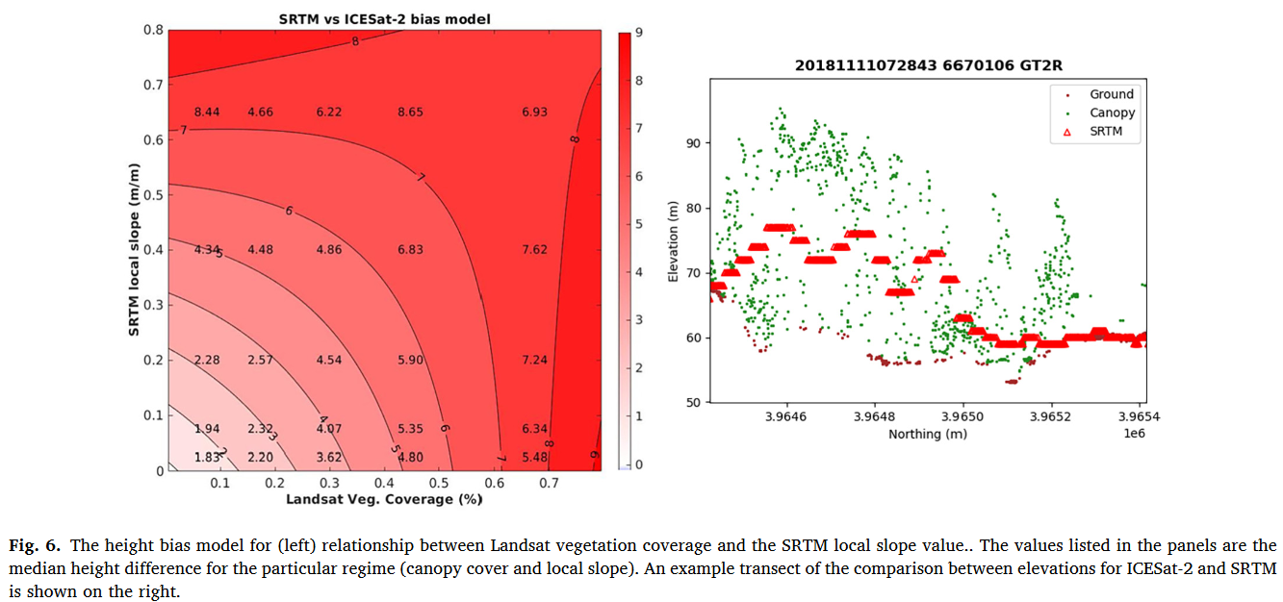
Method ‘CBD’| Results and Discussion | Conclusion and Outlooks
Bias correction: Using ICESat-2 snow-free segments correct DEM
Using ICESat-2 snow free measurements to correct DEM (Magruder et al., 2021)
XGBoost model structure
Magruder, L., Neuenschwander, A., & Klotz, B. (2021). Digital terrain model elevation corrections using space-based imagery and ICESat-2 laser altimetry. Remote Sensing of Environment, 264, 112621.
Chen, T., & Guestrin, C. (2016). XGBoost. Proceedings of the 22nd ACM SIGKDD International Conference on Knowledge Discovery and Data Mining, 785–794.
Notes:
After the co-registration, I found the bias is widespread in residual differences. Since the ICESat-2 also provide the snow-free segments. Is that possible to use ICESat-2 to correct the DEM?
One of research proposes a two-dimensional bias correction method for SRTM using elevation from ICESat-2 ATL08 product, leading to enhanced accuracy of DEM. This correction is based on slope and vegetation coverage. However, the bias can vary across multiple dimensions, for example curvature, aspect.
Therefore, this study employs a regression model based on XGBoost, which is machine learning algorithm in tree structure. This decision tree describe how the bias spread over these features (click), such as terrain parameters, vegetation, and quality metrics from ICESat-2. So this modul can be used to predict the bias and correct the DEM.
The elevation difference between the bias corrected DEM and ICESat-2 snow-on measurements is the real snow depth.
XGBoost are also used in the next step, the statistical downscaling.

Slide 14
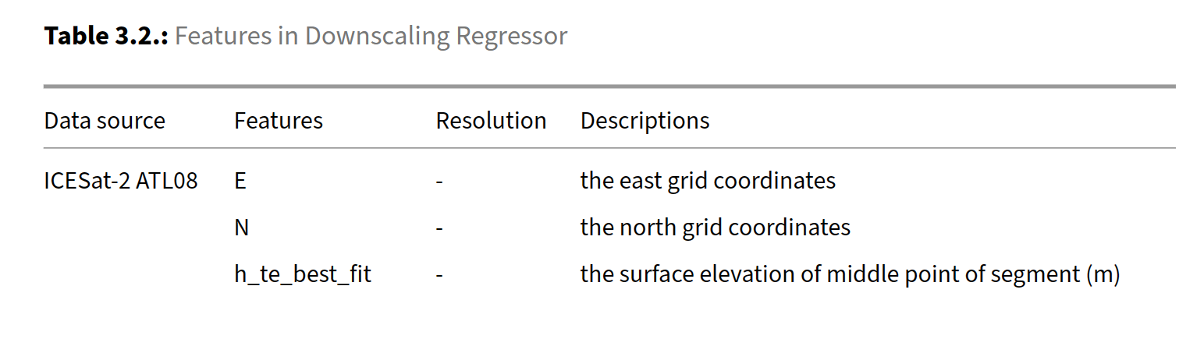

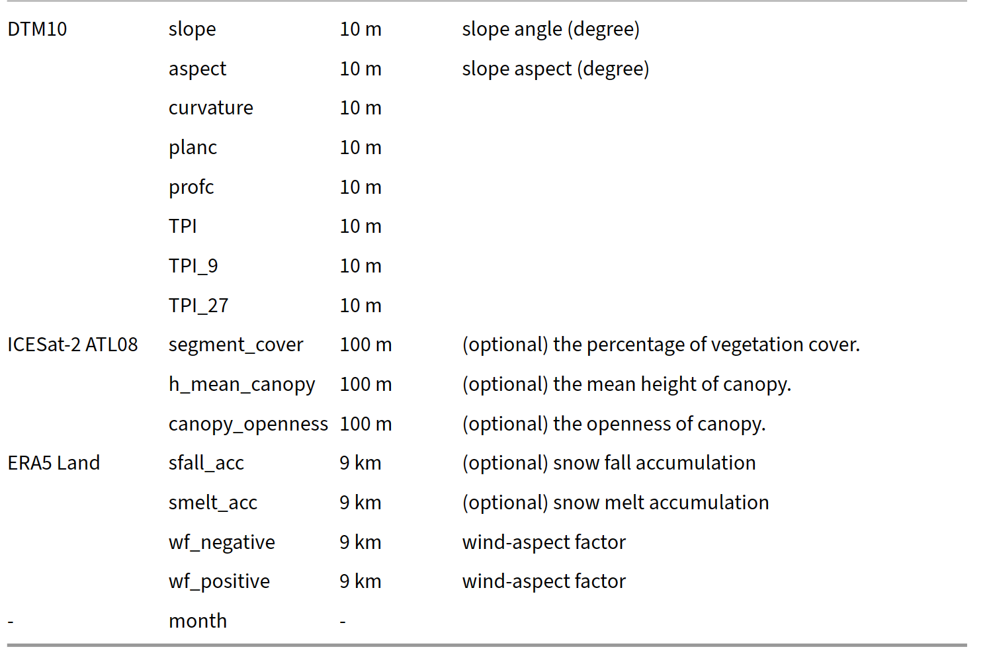
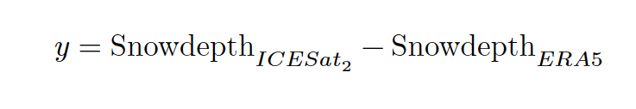
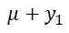
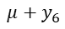
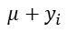
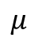
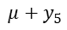
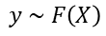
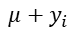
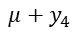
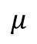
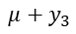
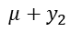
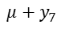
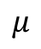
Method ‘CBD’| Results and Discussion | Conclusion and Outlooks
Downscaling: How it works
Snow depth
ERA5 Land (9km)
$$y \sim F\left(X\right)$$
Snow depth
Sub-grid distribution
$$μ+y_{1}$$
$$μ+y_{2}$$
$$μ+y_{3}$$
$$μ$$
$$μ+y_{4}$$
$$μ+y_{5}$$
$$μ+y_{6}$$
$$μ+y_{7}$$
$$…$$
$$μ+y_{i}$$
$$μ$$
$$μ$$
De-trend
Downscaling (XGBoost Regressor)
The predictor features are chosen and pre-pressed to explain the local variability of snow distribution.
Re-trend (anytime, anywhere)
Assumptions:
Stationary Statistical relationship
Explainable predictors.
$$μ+y_{i}$$
Notes:
So, how to used the observed snow depth in downscaling?
First, I have snow depth input from ERA5 Land, which is the mean snow depth representing a grid of 9 km. In the right side, is the snow depth in finer scales, for each cell, there is a value y, representing the local variance. Two datasets are connected by a transfer function.
To train such as the transfer function, we use the snow depth from ICESat-2(click):
First step, is de-trend, to get the local variance of snow depth local, denoted by y here.
Then, to find the predictors (click) in this regression model.
Once we finished the training, this regressor are expected to add subgrid variability to ERA5 at anytime and anywhere.
This workflow assumes (click):
- Stationary Statistical relationship. The regressor are expected to work yesterday, today and tomorrow…
- This workflow also expects informative and explainable predictors. If the local variability can not be fully described by this predictor, this workflow doesn’t work.
Which means it is very important to choose the predictors. Here is the list for all potential predictors, I used the terrain parameters, slope, aspect, curvature, plan curvature, profile curvature, Topographic position index in three different scales, and canopy information from ICESat-2, also the wind fields from ERA5 Land, and snow accumulation and melting information, and month.

Slide 15
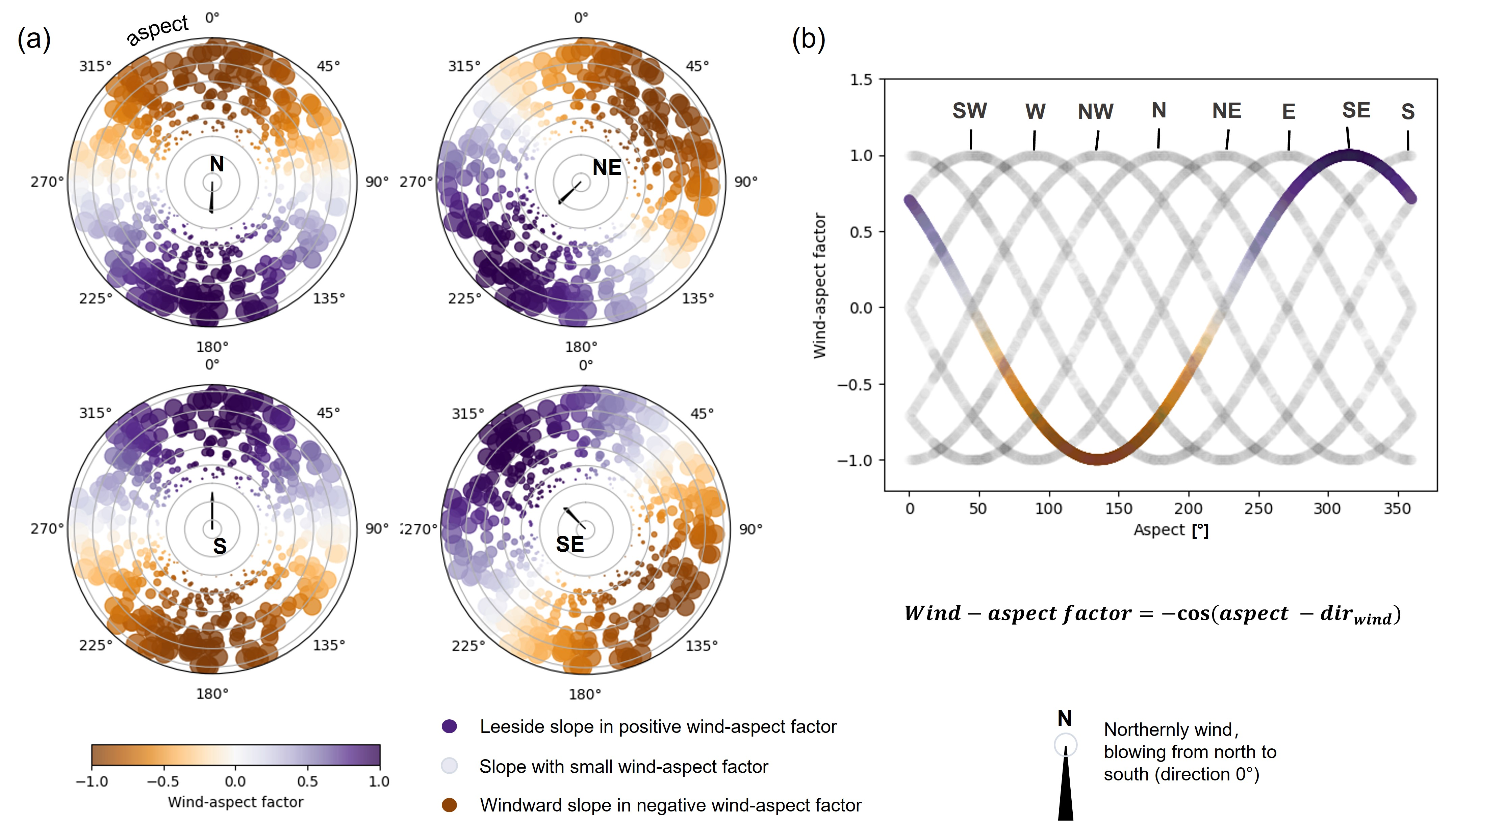
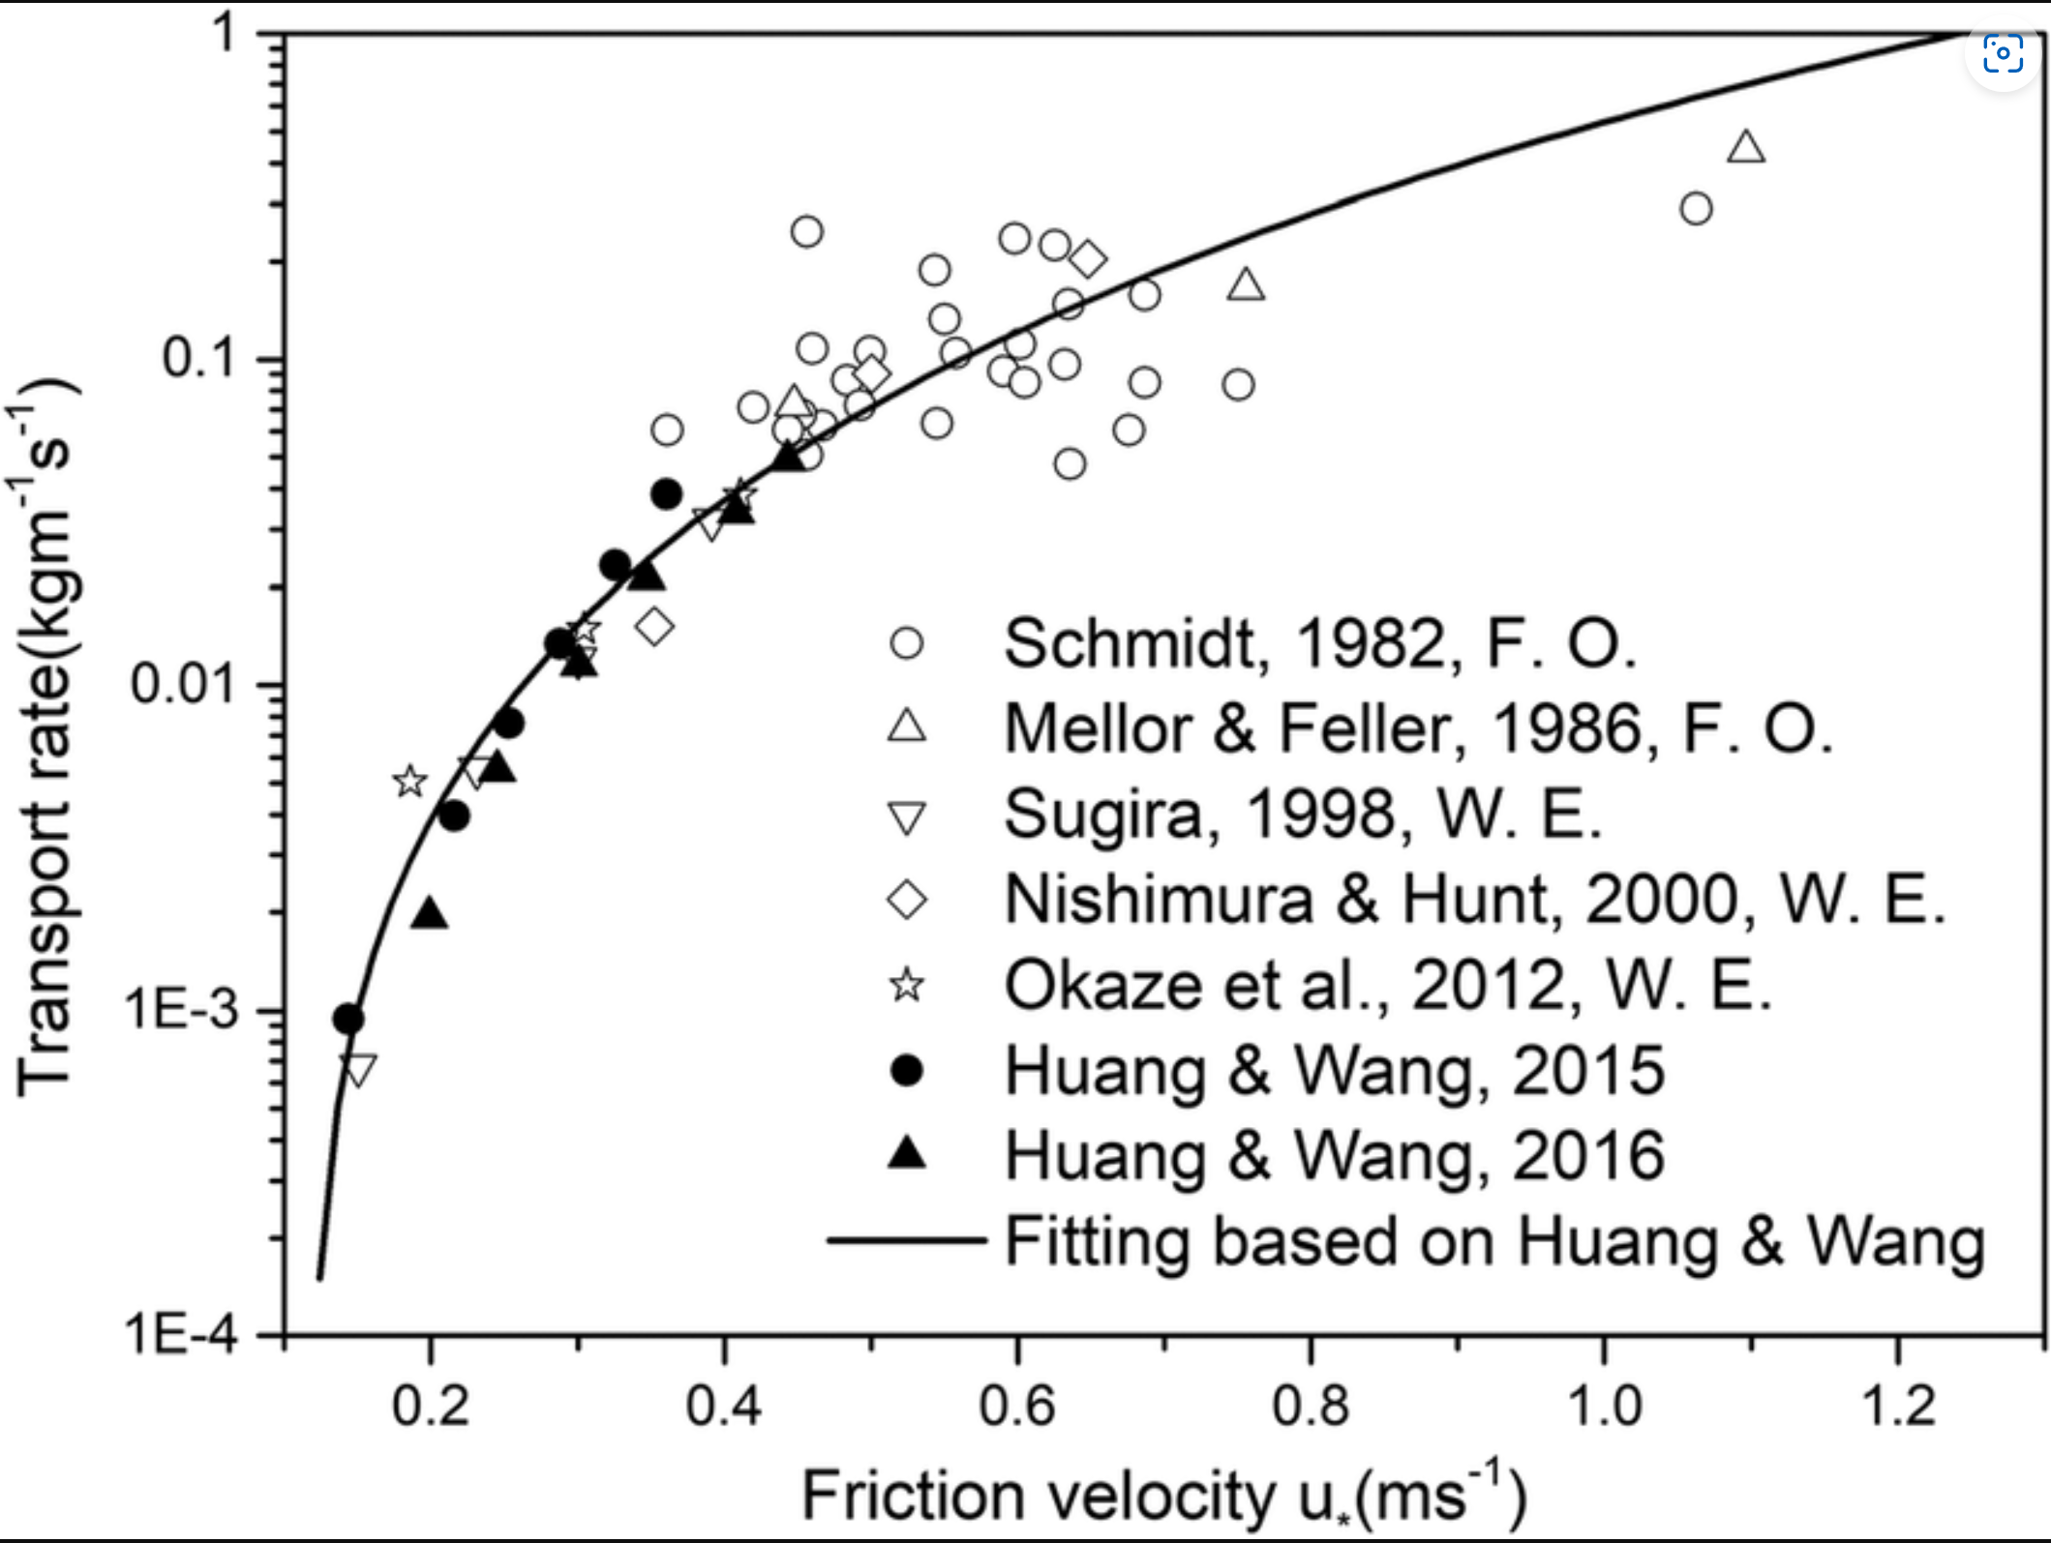
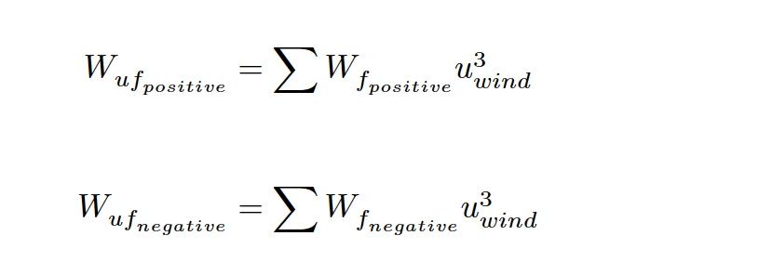
Method ‘CBD’| Results and Discussion | Conclusion and Outlooks
Downscaling: wind-aspect factor $W_{f}$
*Only accumulate when snow depth (ERA5) > 0.1 m
Notes:
So how this work quantifying the effect of wind erosion or redeposition.
I introduced a wind-aspect factor. If the wind is from SE, from snow is going to be re-deposited from this yellow side to lee-side slope, which can be described by a cosine function. Negative means erosion, and positive means deposition. As this effect is an accumulative value (click), and proportional to transport ability of wind. So further develop this factor into an index by calculating the accumulated value during winter using a monthly average of wind speed. The wind is in power of 3 and multiplied with the wind-aspect factor. And the power of 3 is an empirical estimation of transport ability of wind speed.

Slide 16
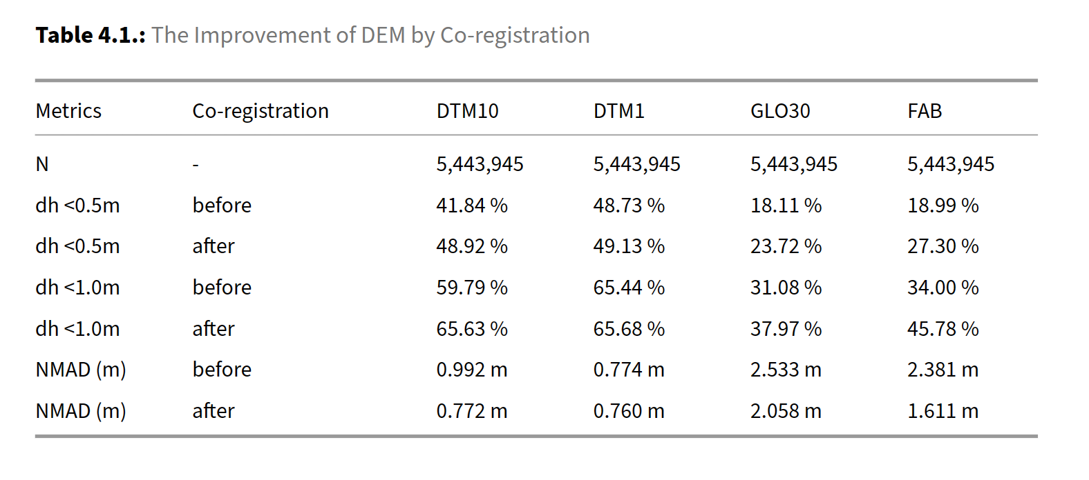
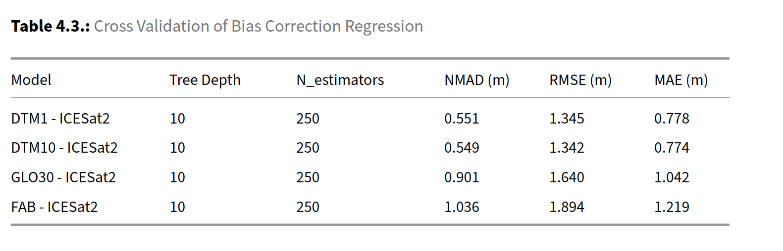
Results and Discussion | Conclusion and Outlooks
Co-registration and bias correction improved the DEM quality
Photo up-sampling tool:: https://huggingface.co/spaces/Xintao/GFPGAN
*The test sample contains 1.1 million points (20%), which is randomly selected from the population.
Notes:
After the co‑registration, the percentage of points with a deviation less than 0.5 m from ICESat‑2 snow‑free segments is calculated to be 48.9%, 49.13%, 23.7%, and 27.2% for DTM1, DTM10, GLO30, and FAB. In terms of NMAD, for example, the DTM are improved from 0.99m to 0.77m
By using ICESat-2 snow free segments as reference to correct DEMs, the overall discrepancy further reduced. The cross validation show that the residual errors are 0.55 m for DTM1 and DTM10, 0.9 m and 1.0 m for Copernicus GLO30 and FABDEM.
The Copernicus GLO30 has also been used in many studies case. For me it is the first time has a NMAD from 2.5 m to be less than 1 m.
This is just the overall discrepancy, if we look into the statistical data binning.

Slide 17
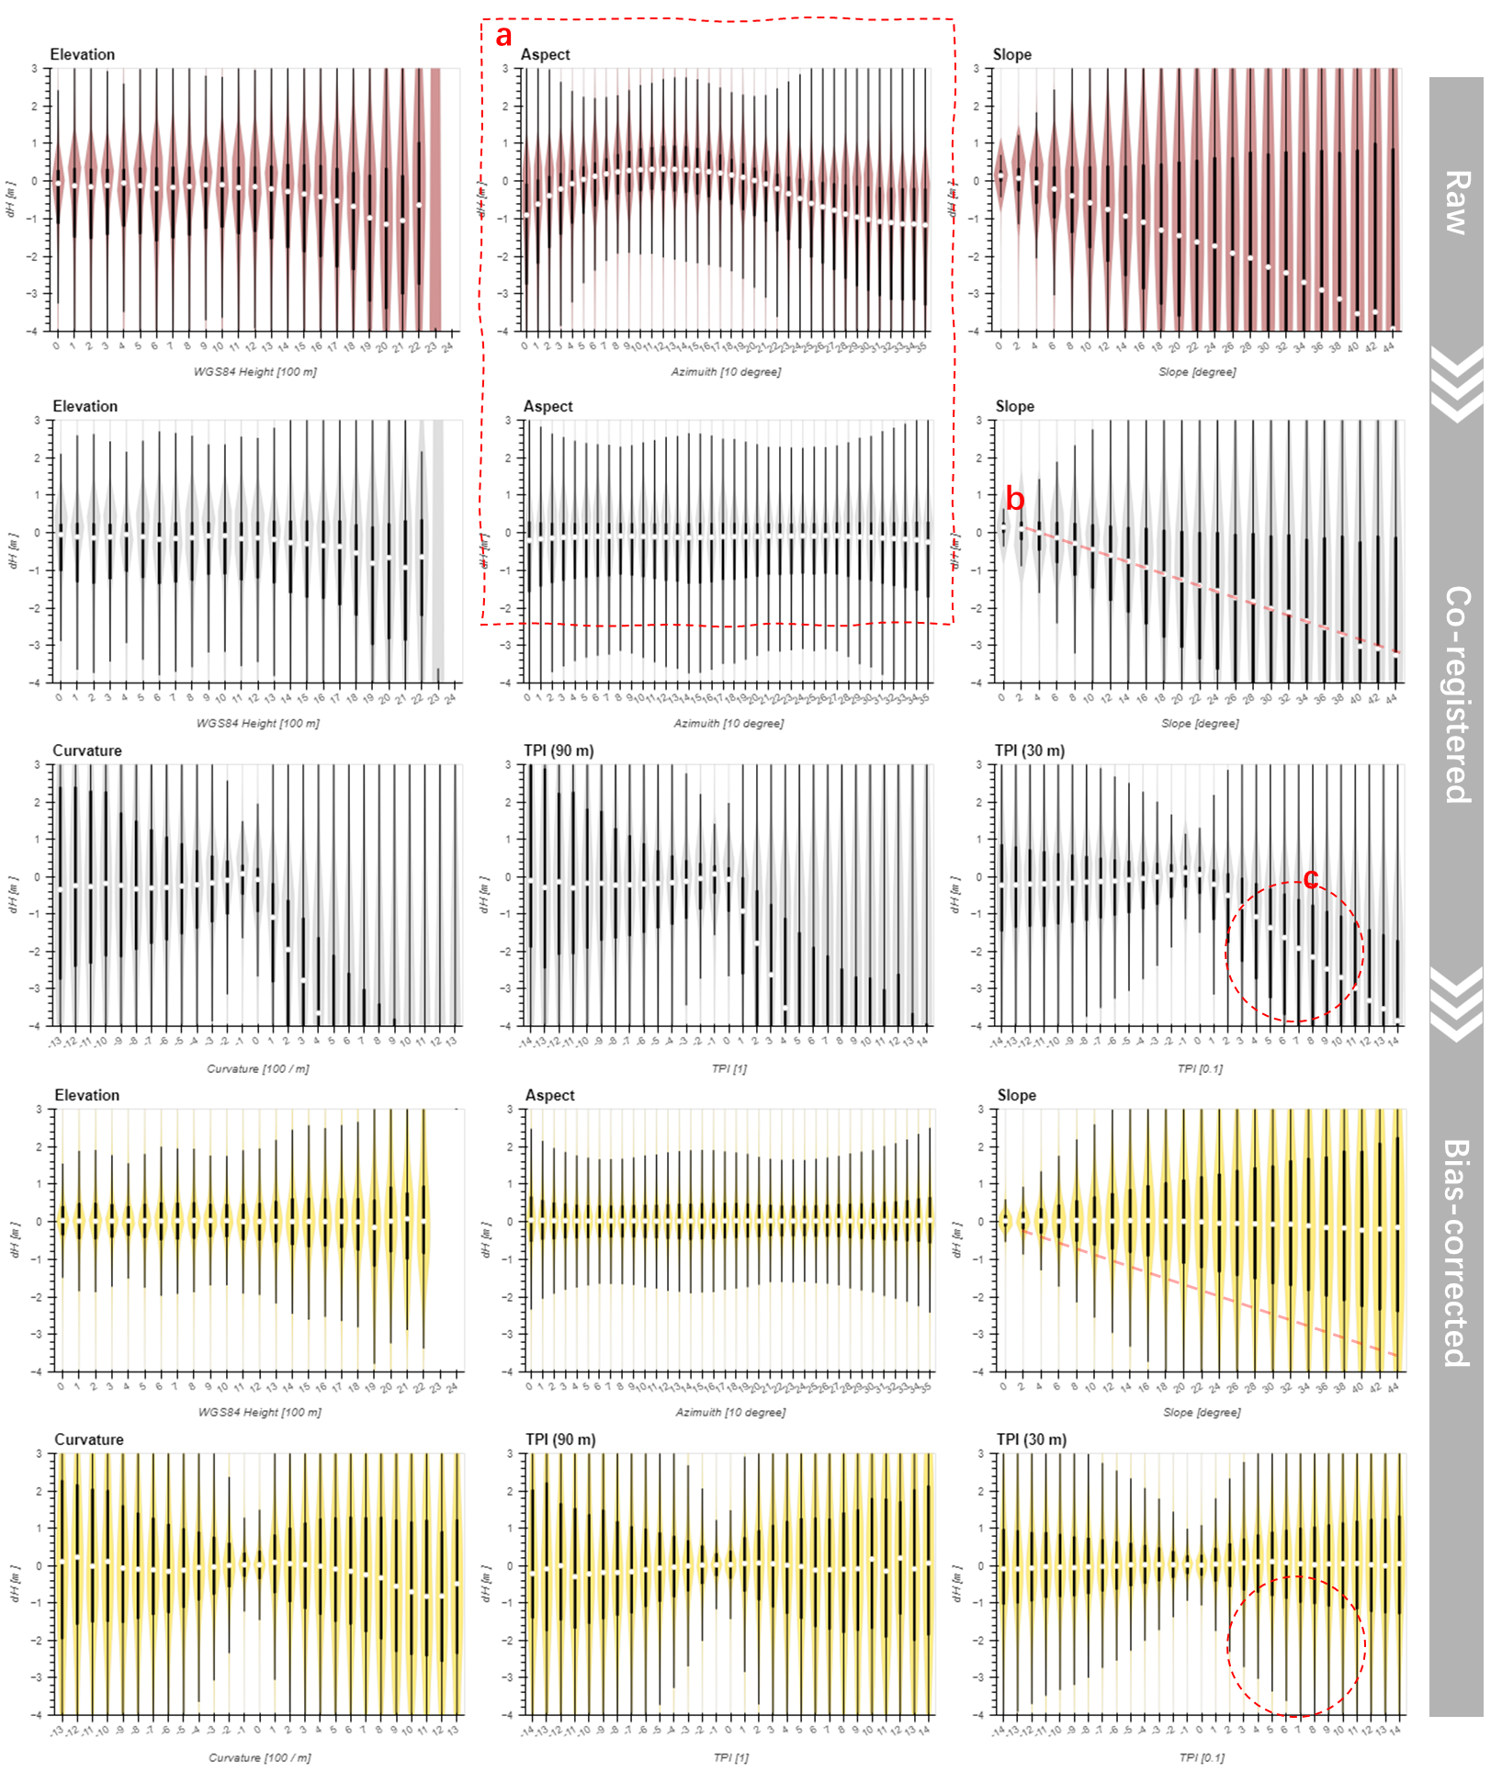
Results and Discussion | Conclusion and Outlooks
ICESat-2 ATL08’s negative skewness is related to curvature
The co-registration removed the aspect-dependent error. However, the 25% quantile (Q1) and the 75% quartile (Q3) are still skewed negative.
Significant negative bias has been identified for large slopes over four DEMs. (Enderlin et al., 2022, Magruder et al., 2021, Tian & Shan, 2021, Moudrý et al., 2022)
The same bias does exist over convex terrain but is not significant over concave terrain, indicated by TPI and curvature bins.
And the bias correction can remove these bias patterns.
Enderlin, et al. (2022). Uncertainty of ICESat-2 ATL06- and ATL08-derived snow depths for glacierized and vegetated mountain regions. Remote Sensing of Environment
Magruder, et al. (2021). Digital terrain model elevation corrections using space-based imagery and ICESat-2 laser altimetry. Remote Sensing of Environment,
Tian, X., & Shan, J. (2021). Comprehensive Evaluation of the ICESat-2 ATL08 Terrain Product. IEEE Transactions on Geoscience and Remote Sensing, 59(10), 8195–8209.
Notes:
This is raw, coreg, bias each step. And the residul error are binned by this violin plot. From example, this is aspect 0 to 360, we can clearly see the aspect-dependent error, this is fingerprint of geo-referencing error, which is removed through co-registration, where the median value (Q2) is located close to zero for all bins.
However, the 25% quantile (Q1) and the 75% quartile (Q3) are still skewed negative (i.e., Q3-Q2 < Q2-Q1) .
(click) Significant negative bias has been identified for large slopes (b) as there exists a nearly linear relationship between median and slope. Some studies have applied vertical bias correction based on slope [@enderlin.etal_2022], slope and vegetation [@magruder.etal_2021], or laser incidence angles and vegetation [@tian.shan_2021]. However, this study shows that the bias does exist over convex terrain but is not significant over concave terrain, indicated by TPI and curvature bins (c).
And the bias correction can remove these bias patterns.

Slide 18
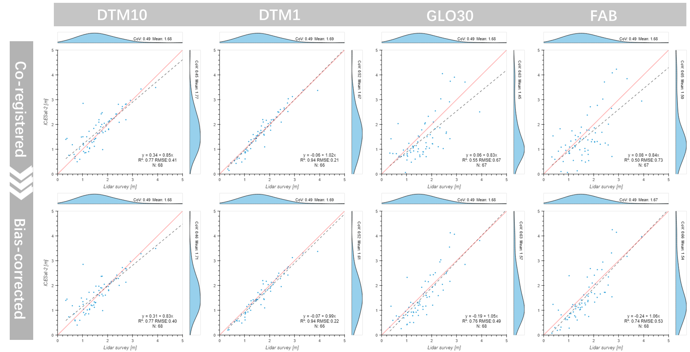
Results and Discussion | Conclusion and Outlooks
The ICESat2‑DTM1 derived snow depth showed excellent correlation (R‑Squared 0.94) to validation
DTM10
DTM1
GLO30
FAB
68
Figure 4.8.: The Validation of ICESat‑2 Derived Snow Depth.
Notes:
In Hardangervidda, the drone trip on gives us 68 valid snow depth measurements, correspond to the ATL08 segments a week ago.(click), Figure right shows a scatter plot indicating a very good agreement, where the DTM1 model has an R-Squared of 0.94 and RMSE of 0.22 m.
It is important to note that the validation snow depth is calculated based on DTM1 as reference ground, so that the DTM10 (has a resolution of 10-meters) got an R-Squared value of 0.77 with an RMSE of 0.40 m. On the other hand, global DEMs such as GLO30 and FAB also achieved good fit after applying bias correction, with R-Squared values of 0.76 and 0.74 and RMSEs of 0.49 m and 0.53 m, respectively.
Note, this validation area is flat, and without much vegetation.

Slide 19
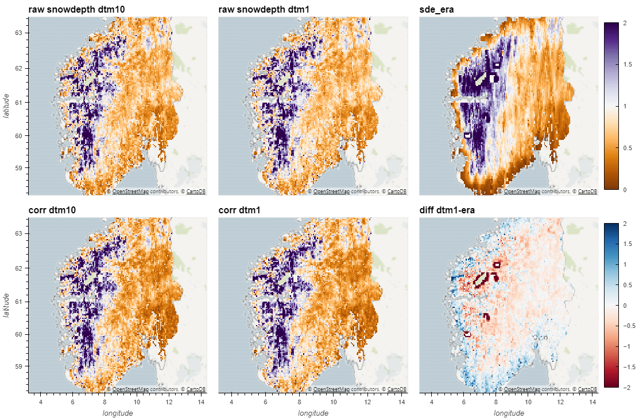
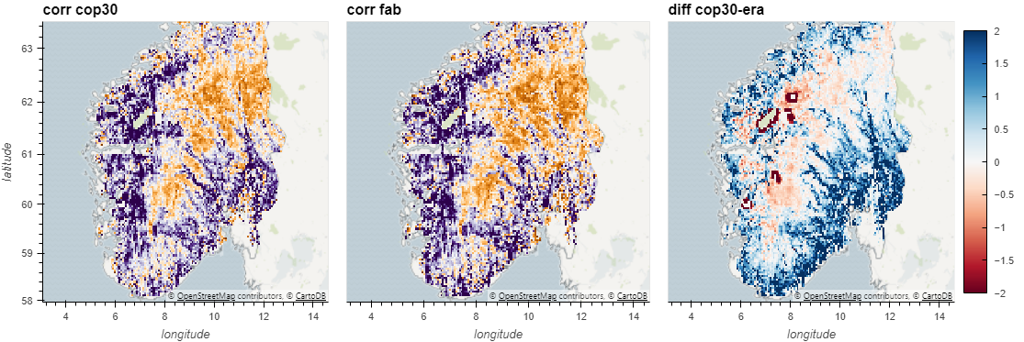
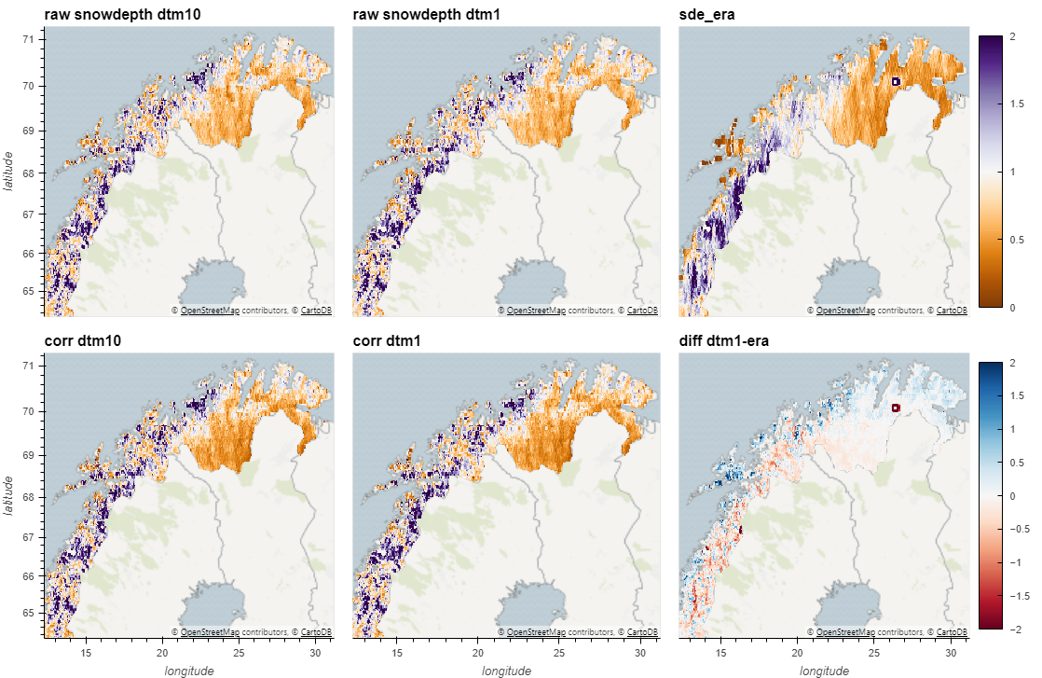
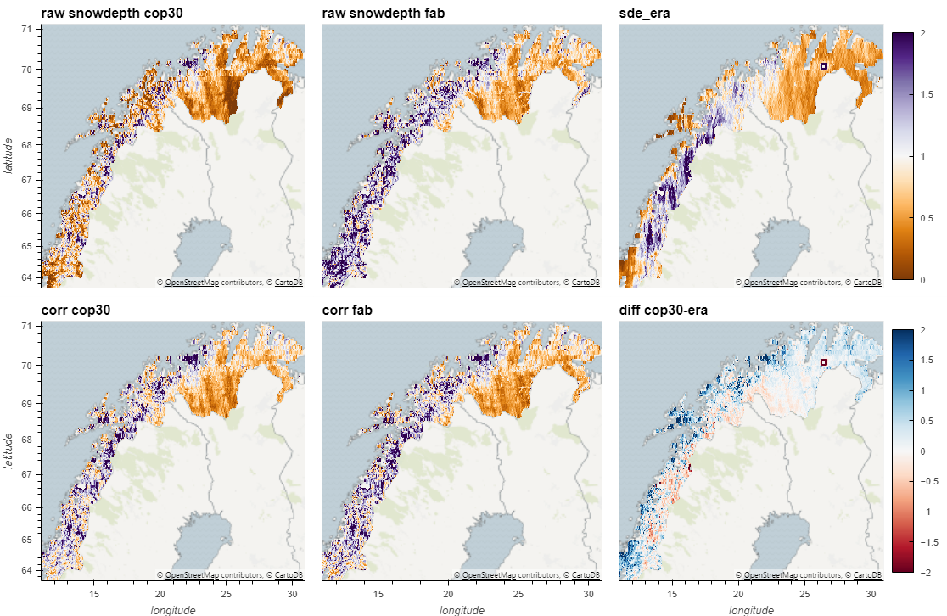
Results and Discussion | Conclusion and Outlooks
The ICESat2 derived snow depth vs ERA5 Land
DTM10
DTM1
DTM1 – ERA5 Land
ICESat-2 derived snow depth
9 million snow-on segments 2018-2022
aggregation
Vs.
ERA5 Land
spatial-temporal coupled
aggregation
Differences [m]
GLO30
FAB
ERA5 Land
Snow depth [m]
DTM10
DTM1
DTM1 – ERA5 Land
Differences [m]
GLO30
FAB
ERA5 Land
Snow depth [m]
Notes:
The second interesting comparison between ICESat-2 derived snow depth and ERA5 Land on a national scale.
This, 1,2,3,4 are 5 millions snow-on segments from 2018 to 2022, after aggregation. In the valleys, the GLO30 and FAB are suffering from trees,
(click) If just look into the difference between DTM1 model and ERA5
We can see the glacier covered area is must out, but because of the resolution, ERA5 still gives over-estimation on snow depth to the surrounding area. Similarly, because of resolution, when the snow cover fraction is very low in coastal area, the ERA5 may under estimate the snow depth. However, I can not conclude which is is wrong, because the scales and representa-tiveness are so different.

Slide 20
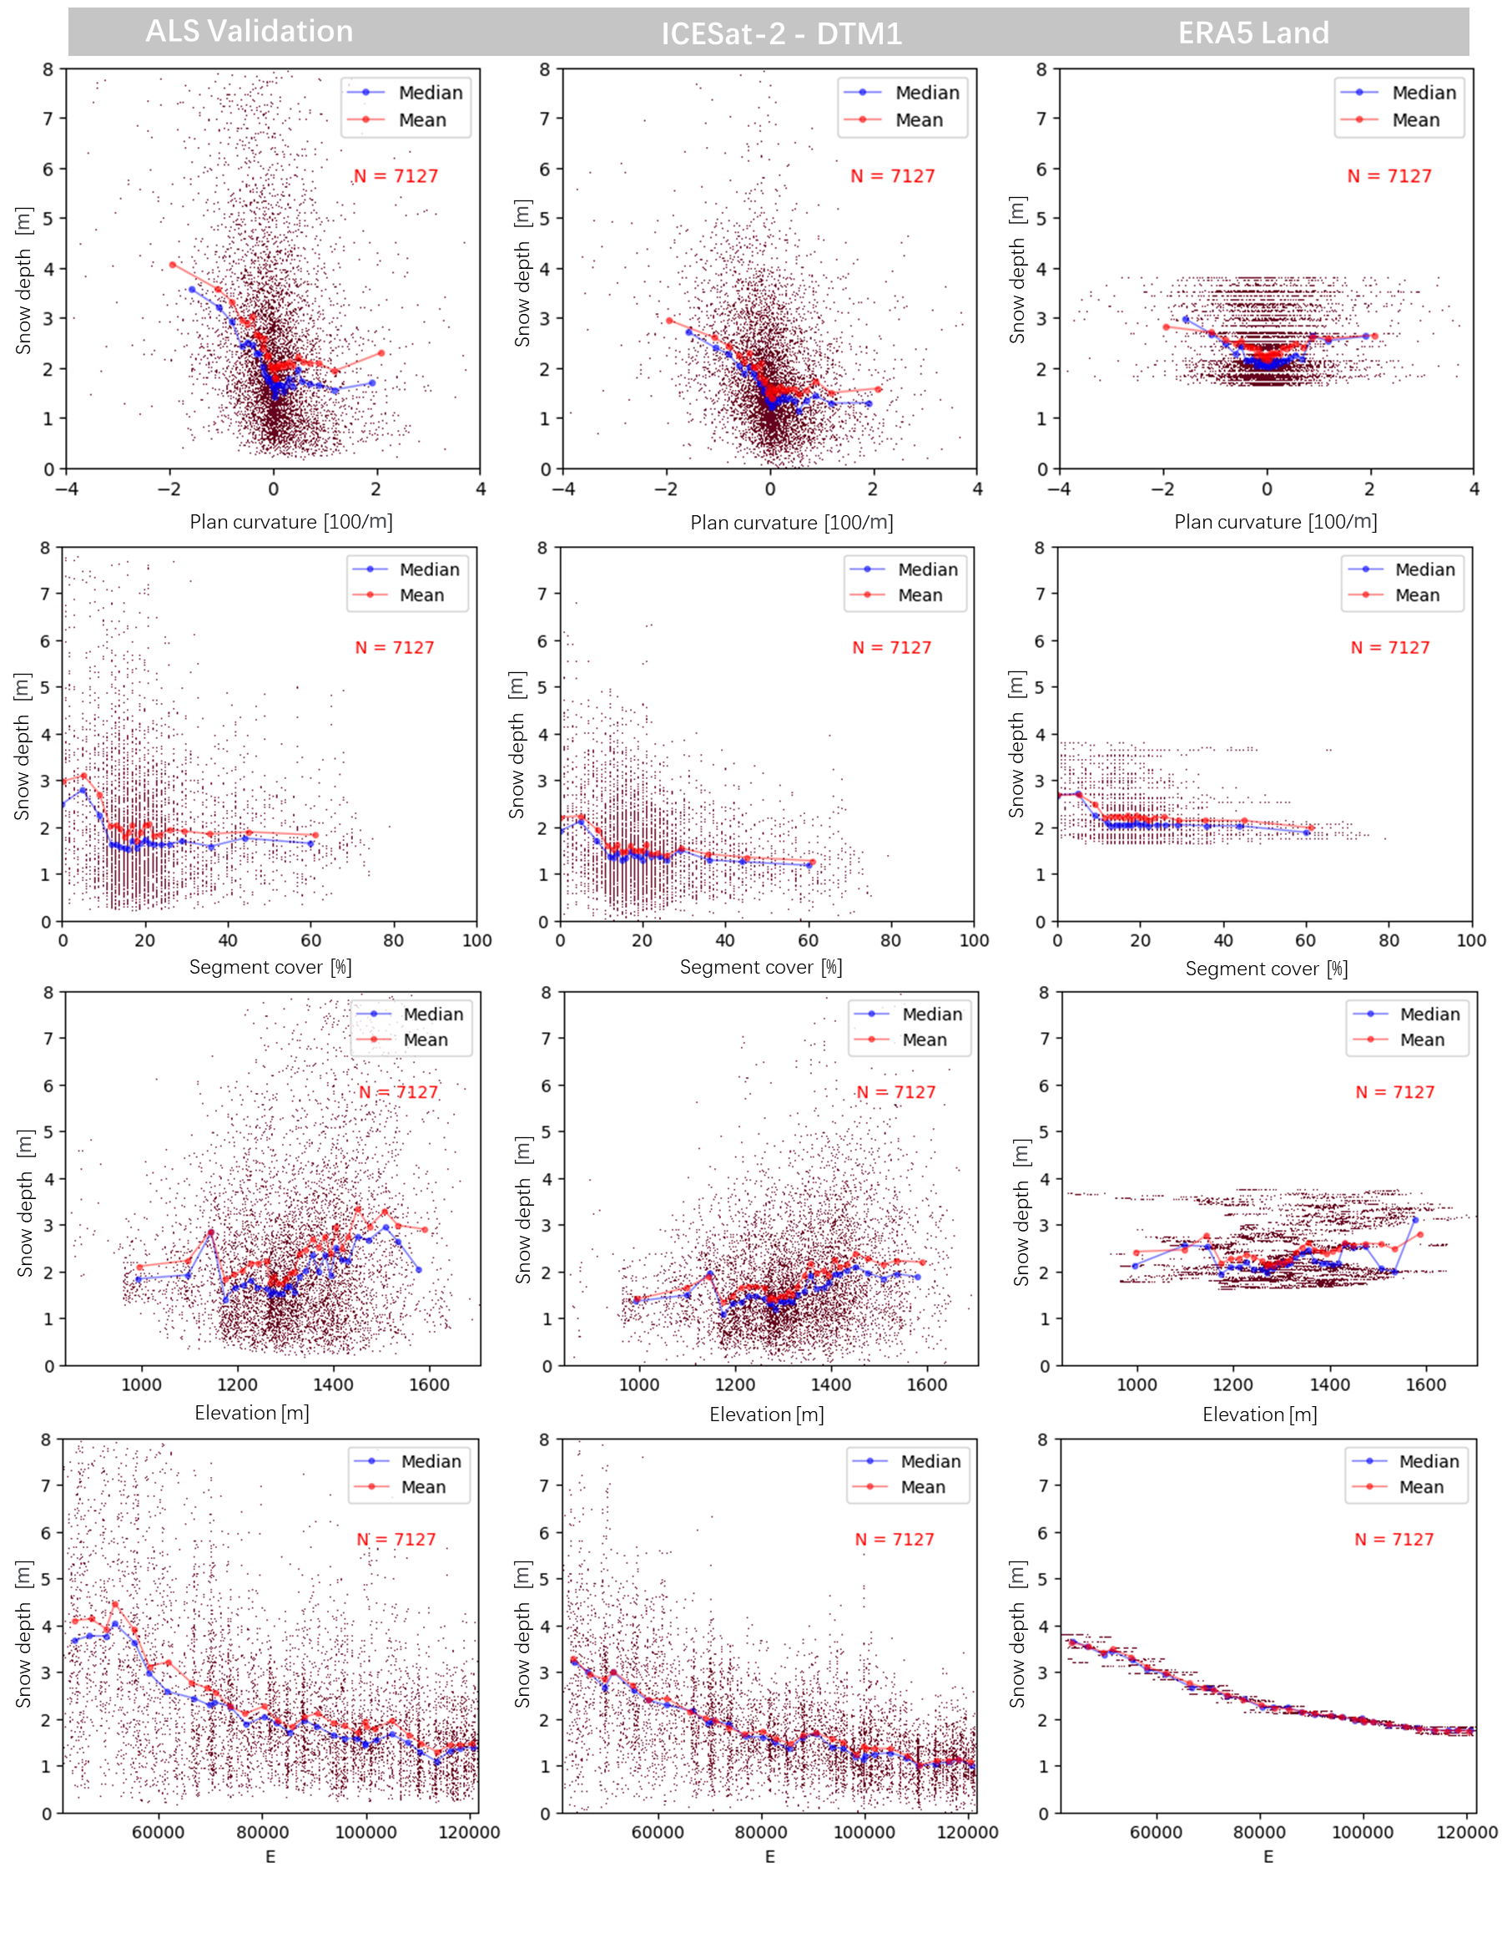
Results and Discussion | Conclusion and Outlooks
Downscaled snow depth
7127
Figure 4.12.: The Validation of Snow Depth Downscaling: Plan Curvature, Vegetation Coverage, Elevation and East.
Notes:
Lets look into downscaled snow depth. This is snow depth survey from NVE at April of 2008, where if I just match the segments of ICESat-2, there are 7000 measurements for validation. (click)
If I plot the snow depth along east coordinates, or elevation, or vegetation cover, or plan curvature. We can see the how it spread over these features. The downscaling it to have a transfer function, inflate the variance from ERA5 to as close as possible to validation.
The pattern is kind of similar, but has a less component on thick snow depth.

Slide 21
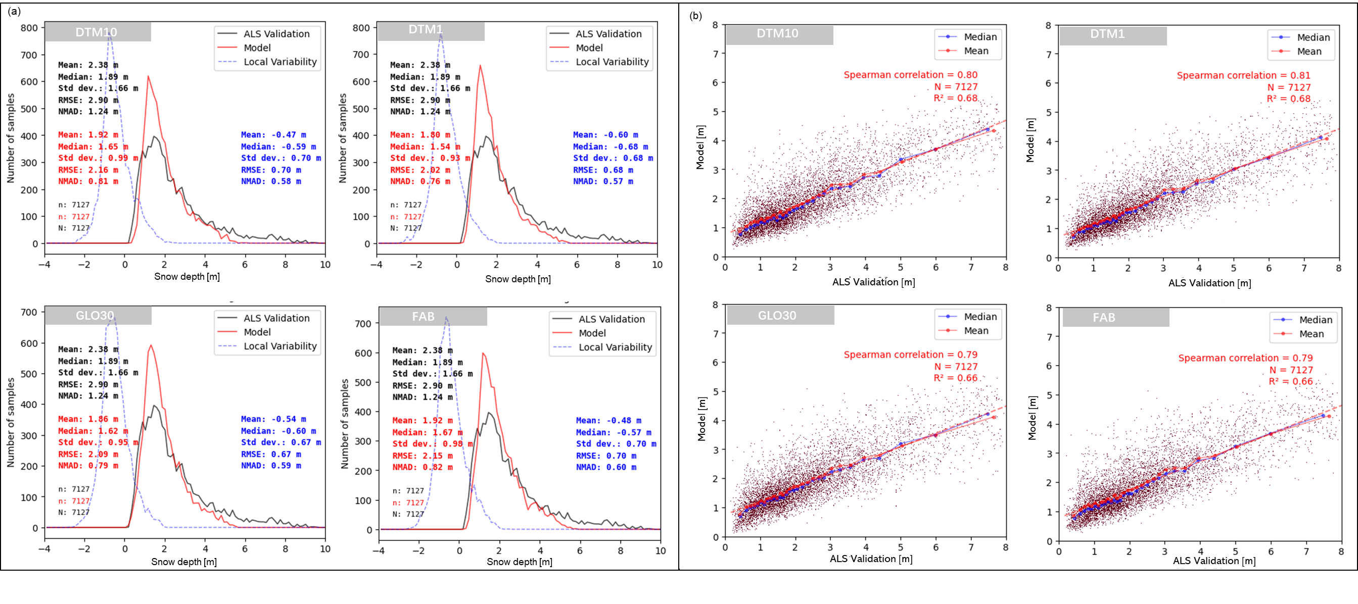
Results and Discussion | Conclusion and Outlooks
Downscaled snow depth has Spearman correlation 0.81 and R-Squared 0.68, and needs bias adjustment
Figure 4.11.: The Validation of Snow Depth Downscaling: Histogram and Scattering.
Notes:
If we used a density plot to visualize what happened in downscaling. It looks like that. The prediction of the local variability, in general has less variance than the observed local variable.
But, overall, the downscaled snow depth has Spearman correlation 0.81 and R-Squared 0.68 for this validation area. And there is a linear shift, it needs bias adjustment.

Slide 22
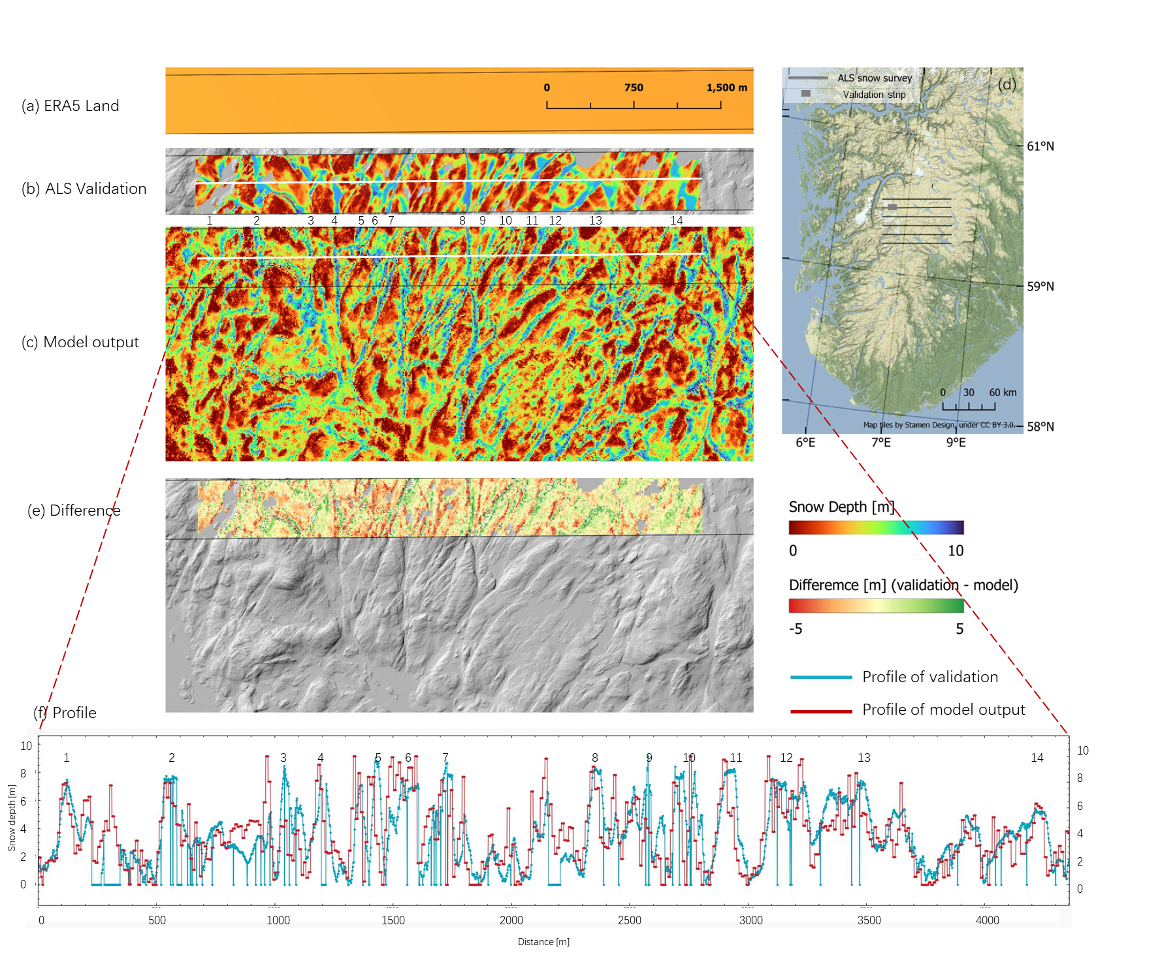
Results and Discussion | Conclusion and Outlooks
Downscaled snow depth vs validation
The validation area:
Strong wind, many small depressions as wind shelter, resulting in high variability of snow depth, and repeated patterns.
The results:
Four DEMs show negligible differences.
Local model has a higher Spearman correlation to the global model.
Figure 4.10.: The Validation of Snow Depth Downscaling (2008.04)
Notes:
I pick a tiny area to visualize the subgrid variability of snow depth which is located in the northwest of the NVE\s survey area.
(a) The snow depth from ERA5 Land that needs to be downscaled shows no variability at this scale.
(b) show significant variations across depressions and hilltops from 0 to 10 meters.
(c) The downscaled snow depth from the ICESat 2 ‑ DTM1 model reproduced most of the variability
(e) If we don’t check the difference, it is not easy to tell the difference.
(f) This is a profile from west to east, the depressions are numbered 1 to 14.
I also found the results from Four different DEMs show small differences in this area. If the traing a local model has a higher Spearman correlation to the global model. The model is trained in a region that is 100 km wider than validation area in all directions. The downscaling model output has a resolution of 10 meters and includes water surfaces where values may not be reliable.

Slide 23

Results and Discussion | Conclusion and Outlooks
Downscaled snow depth vs validation
Figure A.3.: The Validation of Snow Depth Downscaling (2009.04)
Notes:
This is applied the same workflow on 2009 April snow depth.

Slide 24



Conclusion and Outlooks
Downscaled snow depth
This work reproduced snow depth patterns at the hill-slope scale, achieving an R-Squared value of 0.68 and a Spearman correlation coefficient of 0.81.
Further work on downscaling
More validation
Feature engineering
Randomization (Maraun 2013)
Potential applications
Hydrological models (Freudiger 2017)
Avalanche assessment(Jeff Deems)
Permafrost Mapping (Gisnås et al,. 2016)
Gisnås, K., Westermann, S., Schuler, T. V., Melvold, K., & Etzelmüller, B. (2016). Small-scale variation of snow in a regional permafrost model. The Cryosphere
Freudiger, D., Kohn, I., Seibert, J., Stahl, K., & Weiler, M. (2017). Snow redistribution for the hydrological modeling of alpine catchments. Wiley Interdisciplinary Reviews: Water, 4(5), e1232
Maraun, D. (2013). Bias Correction, Quantile Mapping, and Downscaling: Revisiting the Inflation Issue. Journal of Climate, 26(6), 2137–2143. https://doi.org/10.1175/JCLI-D-12-00821.1
Notes:
This work reproduced snow depth patterns at the hill-slope scale, achieving an R-Squared value of 0.68 and a Spearman correlation coefficient of 0.81 when compared to lidar validation in Hardangervidda, Norway.
In the future, this work plans to have more validation. A better feature engineering will keep refine results. And this is an deterministic regression model, without considering randomization, so the downscaling can not reproduce the random component of the variance.
This work has many potential applications. (1) Wind redistribution has been confused hydrologist many years, the accurate snow depth estimation can help hydrological model better estiamting snow melting runoff. (2) Snow has a strong insolation effect, the snow depth can help permafrost modeling a lot. (3) In avalanche mass movement modeling, the release area and the thickness is the most important input parameters. This work are expected save the money for snow survey, and even give the snow distribution pattern in the future scenarios.

Slide 25
Conclusion and Outlooks
A refined elevation workflow
This work reproduced snow depth patterns at the hill-slope scale, achieving an R-Squared value of 0.68 and a Spearman correlation coefficient of 0.81.
‘CBD’ workflow is applicable globally, it differs from others by:
Gradient Descent Co-registration algorithm
Bias correction DEM using ICESat-2 snow free segments.
Further work on elevation differencing workflow
Extend study area
Refine bias correction over vegetated area
Potential applications
- Using ICESat-2 co-registering DEMs
Notes:
This approach is applicable globally in any location where accurate snow-free DEMs are available.
CBD is unique method, because this study contributed a Gradient Descent Co-registration algorithm, which offers possibilities for handling large-scale datasets at a fine resolution. And, a bias correction workflow is utilized to address uncertainties of DEM and ICESat-2, which refines the conventional elevation differencing workflow of producing snow depth.

Slide 26
Conclusion and Outlooks
The negative skewness of ICESat-2 ATL-08
This work reproduced snow depth patterns at the hill-slope scale, achieving an R-Squared value of 0.68 and a Spearman correlation coefficient of 0.81.
‘CBD’ workflow is applicable globally, it differs from others by:
Gradient Descent Co-registration algorithm
Bias correction DEM using ICESat-2 snow free segments.
The negative skewness of ICESat‑2 ATL08 has been observed in many studies. This study high‑lights the critical role played by curvature and vegetation, which is more important than slope and atmospheric scattering. The bias correction proposed in this study can resolve this issue.
Potential applications
- All ICESat-2 ATL08 studies

Slide 27

Hvor mye snø er det egentlig i fjellet?
Av Eivind Torgersen Publisert 13. mai 2022
Thanks

Slide 28




Background | Method ‘CBD’ | Results and Discussion | Conclusion and Outlooks
Study area
Wind
Snow
Mean Temperature
Annual Precipitation
(e) 1961-1990
(f) 1961-1990
(c) Winter 2020-2021
(d) Winter 2021-2022
Notes:
The North Atlantic Current, moderates the range of temperatures throughout the year, particularly along the coastal areas of Norway [@kaspi.schneider_2011; @keil.etal_2020]. During winter, the air temperature is usually lower than the water temperature of the current, resulting in higher evaporation rates [@seppala_2005]. Moist air masses are carried with the westerly winds, leading to heavy precipitation averaging from 1000 to 3000 mm per year in coastal areas when moist air is uplifted by the mountains As, a result, in Scandinavia peninsula, here, Mainland Norway has astonished snow accumulation, particularly in western mountain, where the temperature is relatively low, and more precipitation fall as snow. Seasonal snow plays a crucial role as water reservoirs.

Slide 29


Statement of solutions: Modeling

Slide 30
Hyperparameters and cross‑validation
Photo up-sampling tool:: https://huggingface.co/spaces/Xintao/GFPGAN

Slide 31

2/3 Snow depth is the big unknown
Reanalysis based
Satellite-based
Climatology
Zhou, L., Stroeve, J., Xu, S., Petty, A., Tilling, R., Winstrup, M., Rostosky, P., Lawrence, I. R., Liston, G. E., Ridout, A., Tsamados, M., & Nandan, V. (2021). Inter-comparison of snow depth over Arctic sea ice from reanalysis reconstructions and satellite retrieval. The Cryosphere, 15(1), 345–367.
Notes:
There is a comparison between different snow depth product, it is very different from each other.

Slide 32


Results and Discussion | Conclusion and Outlooks
ICESat-2 ATL08’s negative skewness is related to curvature
Figure 5.1.: Skewness Variations in Convex and Concave Terrains. The elevation difference is between ICESat‑2 snow free segments and DTM1.
Notes:
To further investigating the negative skewness, Figure 5.1 plots nine curvature combinations catego‑ rized by profile curvature and plan curvature. The aggregated mean value of elevation differences reveals that convex ridged terrain (positive plan curvature and negative profile curvature) typically exhibits the negative skewness (Figure 5.1 a,g). A concave bowl‑shaped terrain with negative profile curvature does not have much negative skewness, even at high slopes (Figure 5.1 b), thereby indicat‑ ing that the observed linear relationship between bias and slope (Figure 4.2 b) is mainly contributed by plan curvature. Moreover, the canopy height contributes significantly to positive bias when the canopy is short upon concave terrain, but it cannot equalize for all the observed negative skewness (Figure 5.1 c). Therefore, it can be inferred that plan curvature plays a significant role in influencing skewness. Based on these findings, this study does not recommend any bias correction based solely on slope and/or canopy height. Instead, the bias correction method used in this study can remove the negative skewness over different features (Figure 5.1 d,e,f)

